Slide 1
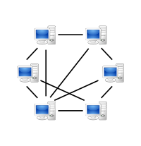

Forensics Investigation of Peer-to-Peer File Sharing Networks
Authors: Marc Liberatore, Robert Erdely, Thomas Kerle, Brian Neil Levine & Clay Shields
Published in Digital Investigation Journal, Vol. 7, pp. 95-103, 2010
Presented By: Danish Sattar

Slide 2
Outline
Introduction
Motivation
Types of Peer-to-Peer Network
Investigative Process
Legal Constraints and Issues
Protocol Analysis
RoundUp
Results & Discussion
Conclusion

Slide 3
Peer-to-Peer Network
An alternative to the client/server model of distributed computing is the peer-to-peer model.
Client/server is inherently hierarchical, with resources centralized on a limited number of servers.
In peer-to-peer networks, both resources and control are widely distributed among nodes that are theoretically equals. (A node with more information, better information, or more power may be “more equal,” but that is a function of the node, not the network controllers.)

Slide 4
Why Peer-to-Peer Networking?
The Internet has three valuable fundamental assets- information, bandwidth, and computing resources - all of which are vastly under utilized, partly due to the traditional client-server computing model.
Information - Hard to find, impossible to catalog and index
Bandwidth - Hot links get hotter, cold ones stay cold
Computing resources - Heavily loaded nodes get overloaded, idle nodes remain idle

Slide 5
Benefits from P2P
Dynamic discovery of information
Better utilization of bandwidth, processor, storage, and other resources
Each user contributes resources to network

Slide 6
Motivation
Child Pornography:
2001: 1,713 arrests for child pornography possession in US
2006: 3,672 arrests
June 2010: 61,169 p2p users observed sharing child pornography
Past studies [Wolak, et al.] have found:
21% of possessors had images of extreme violence
28% had images of children under three
16% of investigations ended with discovery of a contact ofender

Slide 7
Types of Peer-to-Peer Network
Pure p2p system – Gnutella
Hybrid - BitTorrent

Slide 8
Gnutella
GUID
IP Address
Port Number
Who has File X
Names
Sizes
Hash Values

Slide 9



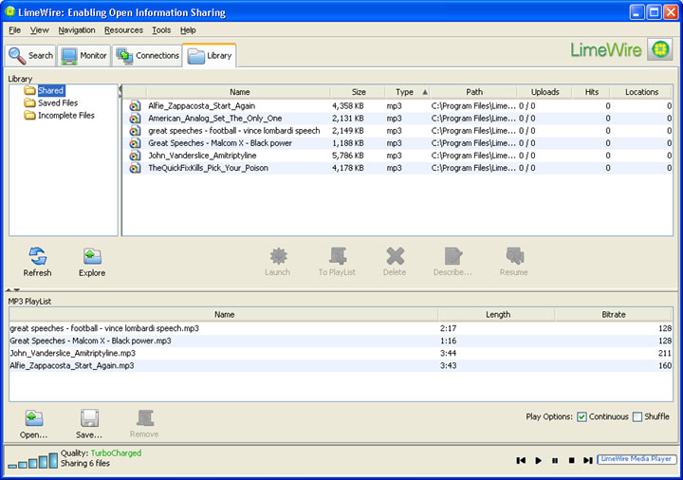
Gnutella Clients
BearShare
Phex
LimeWire

Slide 10
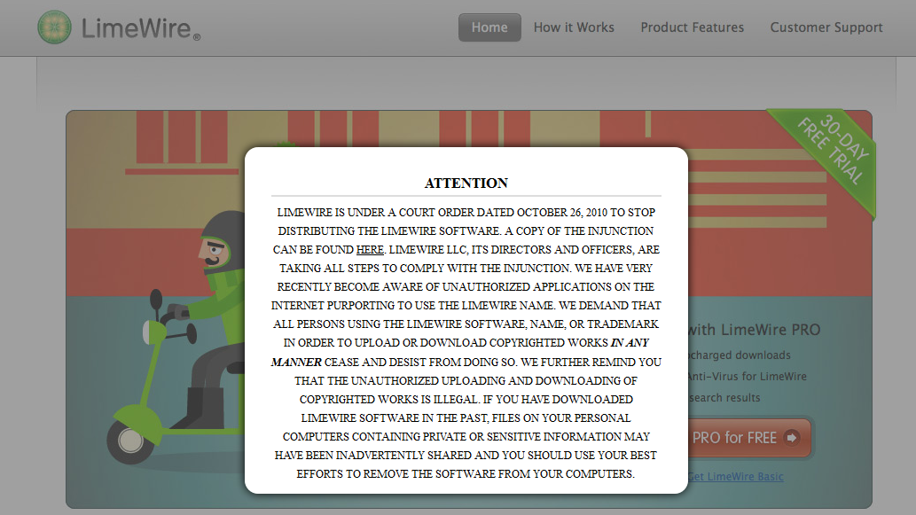
LimeWire’s End?

Slide 11
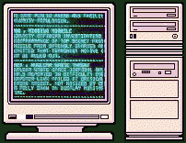

BitTorrent
1
2
Who has File X
3

Slide 12

Torrent World

Slide 13




BitTorrent Clients
µtorrent
Transmission Torrent
BitComet

Slide 14
Investigative Process
An investigator’s end goal is to obtain evidence through observation of data from the Internet.
Evidence
Direct
Hearsay
When an investigator has a direct connection, that is a TCP connection to a process on a remote computer and receives information about that speciﬁc computer
A process on one remote machine relays information for or about another different machine.
Peer in a p2p system may claim another peer possesses a speciﬁc ﬁle
HTTP to transfer ﬁles

Slide 15




Investigation Steps
Files of Interest (FOI)
Collecting leads
Narrowing Down Suspects
Verifying possession of FOI
Suspect identification using GUID
Subpoena to ISP
Search Warrant
The last nail in the coffin

Slide 16
Legal constraints
Investigator’s behavior is bound by the Law
Gathering evidence illegally – inadmissible in court of Law
Investigator must be aware of specifics of p2p protocol under investigation
4th Amendment - Everyone has the right to not be searched or have their things seized unless their is a valid reason. That valid reason must be backed up by facts of what is to be searched or seized and presented to a judge in order to get a warrant.
Kyllo vs US – “The use of a thermal imaging device from a public vantage point to monitor the radiation of heat from a person's home was a "search" within the meaning of the Fourth Amendment, and thus required a warrant”

Slide 17
Legal Issues
Searches
Encryption
Technology
Uploads and Downloads
Record Keeping
Validation

Slide 18
Protocol Analysis - Gnutella
Queries
Swarming Information
Browse Host
File Download
Other Sources of Evidence

Slide 19
Protocol Analysis – BitTorrent
Tracker messages
Piece information exchange
Peer exchange
File download

Slide 20
Evidence use and validation
IP address to physical location of machine
Direct evidence to obtain subpoena for ISP
Get a search warrant
Gnutella – match GUID, shared folder contents
BitTorrent – Download contraband or other related contraband

Slide 21
RoundUp
A tool for forensically valid investigations of the Gnutella network.
Java based tool for local and collaborative investigation.
Gnutella Phex client specific.
Prominent features are: adding speciﬁc functionality, exposing information of interest, automating reporting.
Web based interface to central database.

Slide 22
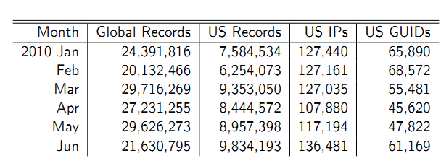
Results – Observed Candidates

Slide 23
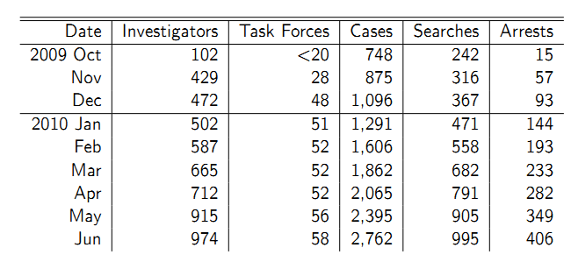
Results – Observed Candidates

Slide 24
Conclusion
The most active venue for trafficking of child pornography is p2p networks, and it is a serious concern of law enforcement.
Successful p2p investigation requires knowledge of the law and of p2p protocols.
If done correctly, P2P protocols provide enough information to successfully investigate criminal acts.
RoundUp – A tool to investigate Gnutella Network.

Slide 25



