Slide 1
COE-589 Carving contiguous and fragmented files with fast object validation
Author: Simson L. Garfinkel
Presented by: Mohammad Faizuddin
g201106390

Slide 2
Outline
Introduction
Limitations of File Carving Programs
Contribution
Related work
Fragmentation in the wild
Experimental Methodology
Object Validation
Pluggable validator framework
Carving with validation
Contiguous carving algorithms
Fragment Recovery Carving
Conclusions
Future work

Slide 3
Introduction
File Carving
Reconstruction of files based on their content, rather than using metadata that points to the content.
Carving is useful for both computer forensics and data recovery.
Challenges
Files to be carved must be recognized in the disk image.
Some process must establish if the files are intact or not.
The files must be copied out of the disk image and presented to the examiner or analyst in a manner that makes sense.

Slide 4
Limitations of File Carving Programs
Most of today’s file carving programs share two important limitations.
Can only carve data files that are contiguous.
Carvers do not perform extensive validation on the files that they carve and , as a result, present the examiner with many false positives.

Slide 5
Contribution
This paper significantly advances our understanding of the carving problem in three ways
First, a detailed survey of file system fragmentation statistics from more than 300 active file systems from drives that were acquired on the secondary market.
Second, this paper considers the ranges of options available for carving tools to validate carved data.
Third, this paper discusses the results of applying these algorithms to the DFRWS 2006 Carving Challenge.

Slide 6
Related work
Defense Computer Forensics Lab developed CarvThis in 1999.
carvThis insipired Agent Kris Kendall to develop a carving program called SNARFIT.
Foremost was released as an open source carving tool.
Mikus extended Foremost while working on his master’s thesis and released version 1.4 in February 2007.
Richard and Roussev re-implemented the Foremost and the resulting tool was called Scalpel.

Slide 7
Related work cont.(2)
Garfinkel introduced several techniques for carving fragmented files in his submission to the 2006 challenge.
CarvFS and LibCarvPath are virtual file system implementations that provide for “zero-storage carving”.
Douceur and Bolosky (1999) conducted a study of 10,568 file systems from 4801 personal computers running Microsoft Windows at Microsoft.

Slide 8
Fragmentation in the wild
A copy of Garfinkel’s used hard drive corpus is obtained for this paper.
Garfinkel’s corpus contains drive images collected over an eight year period (1998-2006) from the US, Canada, England, France, Germany, Bosnia, and New Zealand.
Many of the drives were purchased on eBay.
One third of the drives in the corpus were sanitized before they were sold.
The fragmentation pattern observed on those drives are typically close to the patterns found in drives of forensic interest.

Slide 9
Experimental Methodology
Garfinkel’s corpus was delivered as a series of AFF files ranging between 100 k and 20 GB bytes in length.
Analysis performed using Carrier’s Slueth Kit and a file walking program specially written for this project.
Results stored in text files and later imported into an SQL database where further analysis was performed.

Slide 10
Experimental Methodology Cont.(2)
Slueth Kit identified active file systems on 449 of the disk images in the Garfinkel corpus.
Many drives in Garfinkel corpus were either completely blank or completely formatted with an FAT or NTFS file system.
Only 324 hard drives contained more than five files.
Slueth Kit identified 2,204,139 files with file names of which 2,143,553 has associated data.

Slide 11
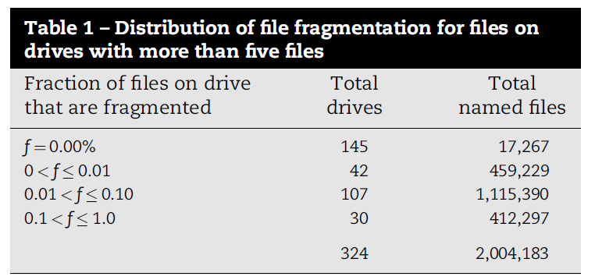
Fragmentation distribution
125,659 (6%) of the files recovered from the corpus were fragmented.
Half of the drives had not a single fragmented file.
30 drives had more than 10% of their files fragmented into two or more pieces.

Slide 12
Fragmentation distribution Cont.(2)
Modern operating systems try to write files without fragmentation because these files are faster to write and to read.
Three conditions under which an operating system must write a file with two or more fragments.
No contiguous region of sectors on the media.
No sufficient unallocated sectors at the end of the file to accommodate the new data.
File system itself may not support writing files of a certain size in a contiguous manner (e.g. Unix File System).

Slide 13
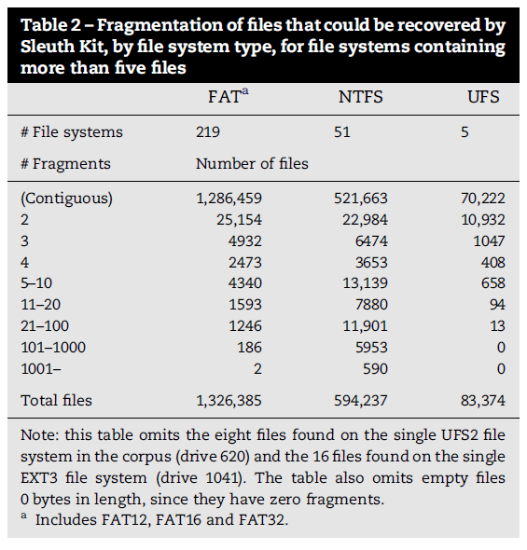
Fragmentation distribution Cont.(3)
Files on Unix File System (UFS) were far more likely fragmented than those on FAT or NTFS volumes.

Slide 14
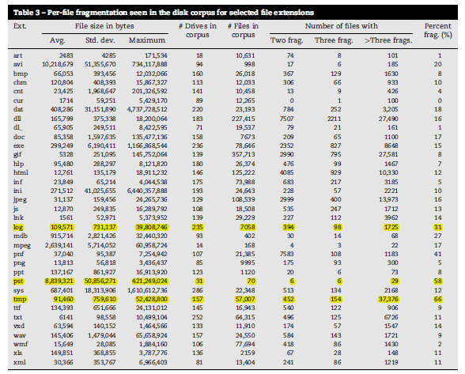
Fragmentation by file extension
High fragmentation rates were seen for log files and PST files.
Surprised to see that TMP files were most highly fragmented.
High fragmentation rates for file types (e.g. AVI, DOC, JPEG and PST ) that are likely to be of interest by forensic examiners.

Slide 15
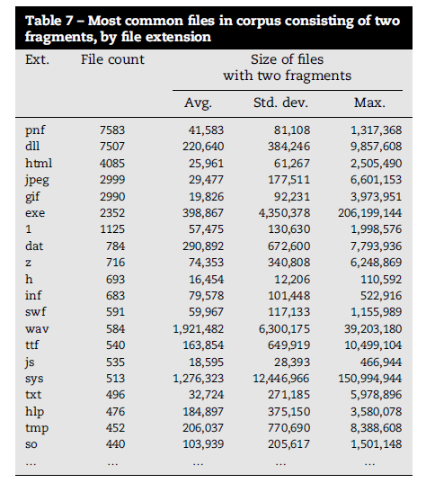
Files split into two fragments
Term bifragmented describe a file that is split into two fragments.
Bifragmented files can be carved using straightforward algorithms.
Table shows bifragmented files observed in the corpus for the 20 most popular file extensions.

Slide 16
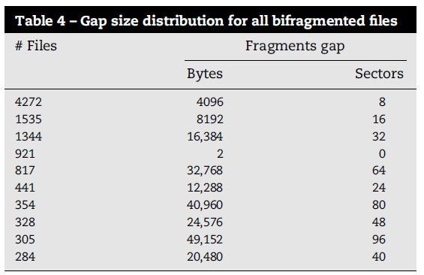
Files split into two fragments Cont.(2)
Performed Histogram analysis of the most common gap sizes between the first and the second fragment.

Slide 17
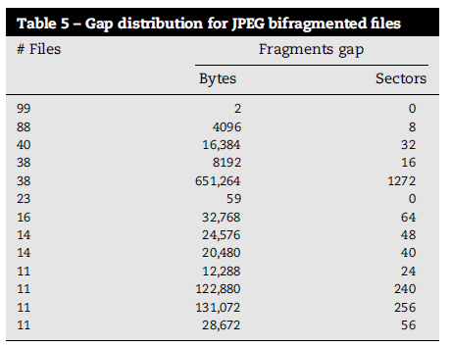
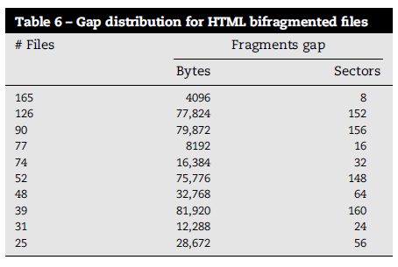
Files split into two fragments Cont.(3)
Tables show common gap sizes for JPEG and HTML files.
Gaps are represented in sectors ( 1 sector = 512 byte).

Slide 18
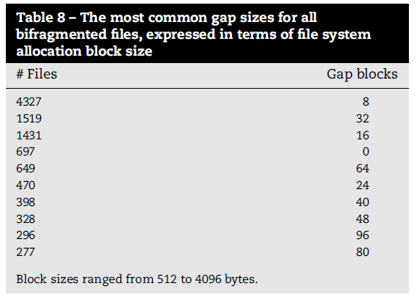
Files split into two fragments Cont.(4)
Table shows more files with a gap of eight blocks than the files with a gap of eight sectors.
It appears that some of the files with gaps of 16 or 32 sectors were actually on file systems with a cluster size of two or four sectors.

Slide 19
Highly Fragmented files
Small number of drives in the corpus had files that were highly fragmented.
Total of 6731 files on 63 drives had more than 100 fragments.
592 files on 12 drives had more than 1000.
Highly fragmented files
Large DLLs and CAB files.

Slide 20
Fragmentation and volume size
Large hard drives are less likely to have fragmented files than the smaller hard drives.
In the Garfinkel’s corpus
303 drives were smaller than 20GB.
21 were larger than 20GB.
Most highly fragmented drives
10-20 GB range (e.g. A 14 GB drive had 43% of drive’s 2517 JPEGs were fragmented).
Fragmentation does appear to go down as drive size increases
4.3 GB drive had 34% fragmentation.
9 GB drive had 33% fragmentation.

Slide 21
Object Validation
Object Validation
process of determining which sequence of bytes represent valid Microsoft Office files, JPEGs, or other kinds of data object.
Object Validation is a superset of file validation
It is possible to extract, validate and ultimately use meaningful components from with in a file (e.g. extracting a JPEG image embedded with in a Word file).

Slide 22
Fast object Validation
Validator
attempts to determine if a sequence of bytes is a valid file.
A disk with n bytes has (n)(n+1)/2 possible strings; thus, a 200 GB hard drive require 2.0 X ${10}^{22}$ different validations.
JPEG decompressor in FAT or NTFS file systems reduces the number of validations from 1.9 X ${10}^{22}$ to 4 X ${10}^{8}$.

Slide 23
Validating Headers and Footers
Verifies static headers and footers.
JPEG files
begin with FF DE FF followed by an E0 or E1.
end with FF D9.
Chance of these patterns occurring randomly in any arbitrary object is 2 in $2^{48}$.
Limitation
Fails in discovering sectors that are inserted, deleted or modified between header and footer because these sectors are never examined
Should be used to reject a data.

Slide 24
Validating Container Structures
JPEG file
Contains metadata, color tables and Huffman-encoded image.
Zip files
Contains directory and multiple compressed files
Microsoft word files
Contains Master Sector Allocation Table, a Sector Allocation Table, a Short Sector Allocation Table, a directory and one or more data streams.

Slide 25
Validating Container Structures Cont.(2)
Container structures have integers and pointers.
Validating requires checking
If an Integer is within a predefined range.
Or Pointer points to another valid structure.
Container structure validation is more likely than header/footer validation to detect incorrect byte sequences or sectors.

Slide 26
Validating with decompression
Validate actual data contained.
Huffman-code is decompressed to display JPEG image.
JPEG decompressor frequently decompress corrupt data for many sectors before detecting error.
2006 challenge
A photo present in two fragments (from sectors 31,533-31,752 and 31,888-32,773).

Slide 27
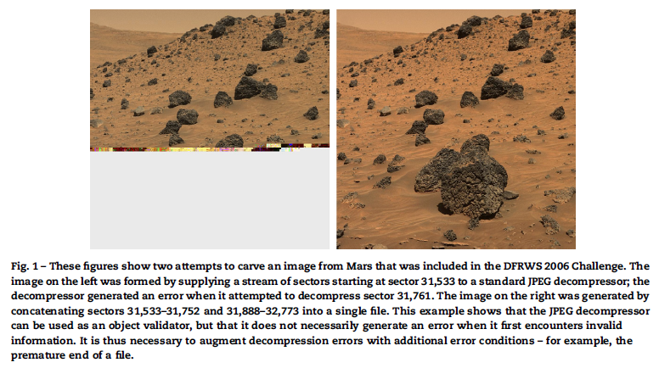
Validating with decompression Cont.(2)
JPEG decompressor
Input contiguous stream of sectors.
Does not generate error until it reaches 31,761.
9 sectors in the range 31,733-31,760 decompress as valid data, even though they are wrong.

Slide 28
Validating with decompression Cont.(3)
JPEG decompressor
Decompress many invalid sectors before realizing the problem.
For a corrupted data never conclude that the entire JPEG had been properly decompressed without error.
Successful as a validator.

Slide 29
Validating with decompression Cont.(4)
Using JPEG decompressor
Able to build a carving tool
Carving tool
Automatically carve both contiguous and fragmented JPEG files on the DFRWS 2006 with no false positives.
Six contiguous JPEGS identified and carved in 6 s.

Slide 30
Semantic validation
Use of English and other human languages to automatically validate data objects.
Garfinkel solved part of the 2006 Challenge
Using manually tuned corpus recognizer that based its decisions on vocabulary unique to each text in question.

Slide 31
Manual validation
Manual validation
Users think accurate way to validate an object.
Still not definitive.
Word and Excel open files that contain substituted sectors.
Open file and examine with human eyes
Not possible in automated framework.
Best object validators give false positive.

Slide 32
Pluggable validator framework
Implements each object validator as a C++ class.
Framework allows
Validator to perform fast operations first
Slow operations only if the fast ones succeed
To provide feedback from validator to the carvers.

Slide 33
Validator return values
Validator supports a richer set of returns for more efficient carvers.
Validator return values | Description
V_OK | The supplied string validates
V_ERR | The supplied string does not validate
V_EOF (Optional) | Validator reached the end of the input string with out encountering an error.
object_Length (Optional) | A 64 bit integer which is the number of bytes that object’s internal structure implies the file must be.

Slide 34
Validator methods
Validator must implement one method Validation_function().
Validation_function()
Input is sequence of bytes.
Returns
V_OK if sequence validates.
V_ERR if it does not.
Optionally V_EOF if the validator runs out of data.

Slide 35
Validator methods Cont.(2)
Validators may implement additional methods for
Sequence(s) of bytes in
File header.
File footer.
A variable that indicates the allocation increment used by file creators
JPEG files allocated in 1-byte increments.
Office files allocated in 512-byte increments.
Err_is_prefix flag.
Appended_data_ignored flag.
No_zblocks flag.
Plaintext_container.
Length_function.
Offset_funtion.

Slide 36
Validator methods Cont.(3)
Implemented three validators with this architecture
V_jpeg
Checks JPEG segments and attempts to decompress the JPEG image using a modified libjpeg version.
V_msole
checks CDH, MSAT, SAT, and SSAT of Microsoft office and attempts to extract text out of the file using wvWare library.
V_zip
Validates the ZIP ECDR and CDR structures then uses unzip –t command to validate the compressed data.

Slide 37
Carving with validation
Developed a carving framework that allows to create carvers that implement different algorithms using a common set of primitives.
Framework
Starts with a byte in a given sector.
Attempts to grow the byte into a contiguous run of bytes .
Periodically validating the resulting string.

Slide 38
Carving with validation Cont.(2)
Several optimizations are provided
Carver maintains a map of sectors that are
Already carved.
Available for carving.
If zblock flag set, the run is abandoned if the carver encounters a block filled with NULs.
If err_is_prefix flag set, the run is abandoned when the validator stops returning V_EOF and start returning V_ERR.
If appended_data_ignored flag set, the run’s length found by performing binary search on run lengths.

Slide 39
Carving algorithms
Contiguous carving algorithms
Support block based carving
Support Character based carving
Fragment Recovery Carving
Carving method in which two or more fragments are reassembled to form the original file or object.
Garfinkel called this approach “split carving”.

Slide 40
Contiguous carving algorithms: Header/footer carving
Carving files out of raw data using
Distinct header
Distinct footer
Algorithm works
By finding all strings contained within the disk image with a set of headers and footers
And submitting them to the validator

Slide 41
Contiguous carving algorithms: Header/maximum size carving
Submits strings to the validator that begin with each discernible header and continue to the end of the disk image.
Binary search is performed to find the longest string sequence that still validates.
Header/maximum size carving works because
Many file formats (e.g. JPEG, MP3) do not care if additional data are appended to the end of a valid file.

Slide 42
Contiguous carving algorithms: Header/embedded length carving
Carver scans the image file for sectors that can be identified as the start of file.
Sectors are taken as the seeds of objects.
Seeds are grown one sector at a time by passing each object to the validator.
Validator returns
Length of the object.
V_ERR.
If length is found, information is used to create test object for validation.
If object is found with a given start vector, the carver moves to next sector.

Slide 43
Contiguous carving algorithms: File trimming
Trimming
Removing content from the end of an object that was not part of the original file.
Two ways for automating trimming
Footer trimming (In case of JPEG and ZIP).
Character trimming (byte-at-a-time formats).

Slide 44
Fragment Recovery Carving: Bifragment Gap Carving
Improved algorithm for split carving.
Places gap between the start and the end flags.
O($n^{2}$) for carving a single object for file formats with recognizable header and footer.
O($n^{4}$) for finding all bifragmented objects of a particular type.
g= $s_{2}−(e_{1}+1)$

Slide 45
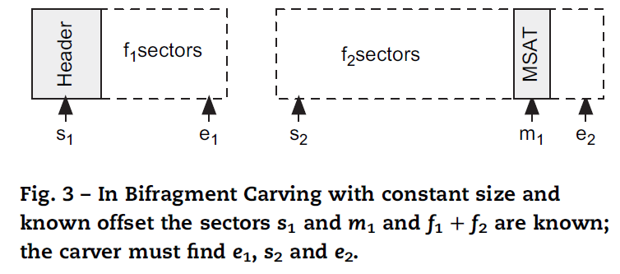
Fragment Recovery Carving: Bifragment Carving with constant size and known offset
Carver makes use of CDH to find and recover MSOLE files.
Employs an algorithm similar to gap carving except that the two independent variables are
Number of sectors in the first fragment.
Starting sector of the second fragment.

Slide 46
Fragment Recovery Carving: Bifragment Carving with constant size and known offset
O($n^{3}$) if
CDH location is known.
MSAT appears in the second fragment.
O($n^{4}$) if
The forensic analyst desires to find all bifragmented MSOLE files in the disk image.
2006 challenge
Able to recover all Microsoft word and Excel files that were split in two pieces.
Number of false positives was low and were able to manually eliminate the incorrect ones.
Challenge was in three pieces.

Slide 47
Conclusions
Files contain significant internal structure, that can be used
To improve today’s file carvers.
Carve files that are fragmented into more than one piece
Carvers should attempt to handle the carving of fragmented files.

Slide 48
Future work
Modify our carver to take into account the output of SleuthKit and see how many orphan files can actually be validated.
Integrate semantic carving into our carving system.
Developing an intelligent carver that can automatically suppress
The sectors that belong to allocated files
Sectors that match sectors of known good files.

Slide 49
Thank you

