Slide 1
King Fahd University of Petroleum and Minerals
Department of Computer Engineering
COE589: Digital Forensics
Student name : Allam Fatayer
Student ID: g20100372

Slide 2
Using NLP techniques for file fragment classification
Simran Fitzgerald, George Mathews, Colin Morris, Oles Zhulyn
Department of Computer Science, University of Toronto, Canada

Slide 3
Outline :
Introduction
Terminology
Problem
Related Work
Contribution
Data Set
Feature Vector
Result
Conclusion
Flaws.

Slide 4
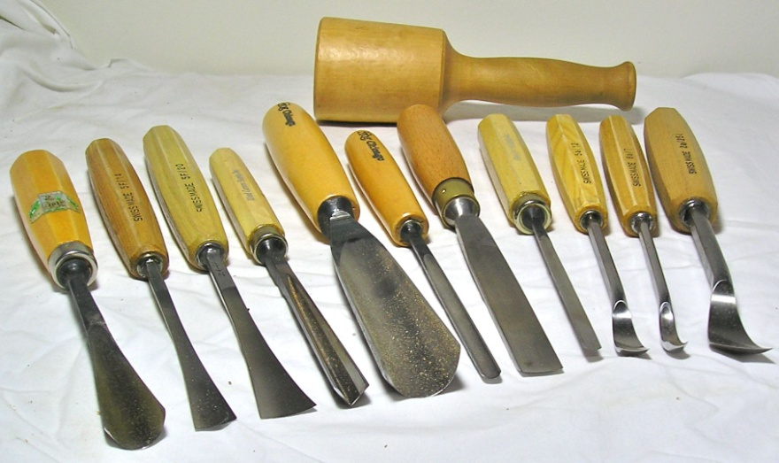
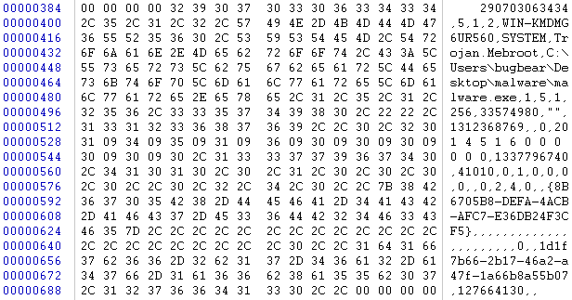
Introduction

Slide 5
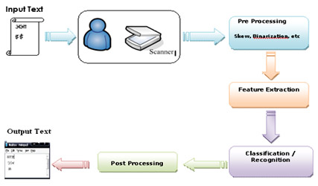
Terminology(1)
Natural Language processing : NLP
is a field of computer science, artificial intelligence, and linguistics concerned with the interactions between computers and human (natural) languages.
Many challenges in NLP involve natural language understanding -- that is, enabling computers to derive meaning from human or natural language input.
NLP Technology: information extraction , machine translation , vision and language , natural language interface.

Slide 6
Terminology(2)
Machine learning :a branch of artificial intelligence
concerned with the design and development of algorithms that take as input empirical data, and yield patterns or predictions thought to be features of the underlying mechanism that generated the data.

Slide 7
Terminology(3)
classification : is the problem of identifying to which of a set of categories (sub-populations) a new observation belongs, on the basis of a training set of data containing observations (or instances) whose category membership is known.
Entropy : is a measure of the unpredictability of an information stream , The idea of entropy of information is credited to Shannon who gave a formula to express it.

Slide 8
Terminology(4)
Support vector machines (SVMs)
● Represent file fragments as high-dimensional
vectors, where each dimension is some “feature” of the file fragment
● During training, SVM takes feature vectors with known file types, and partitions feature space such that each partition corresponds to a file type.
● During testing, check into which partition
feature vector falls

Slide 9
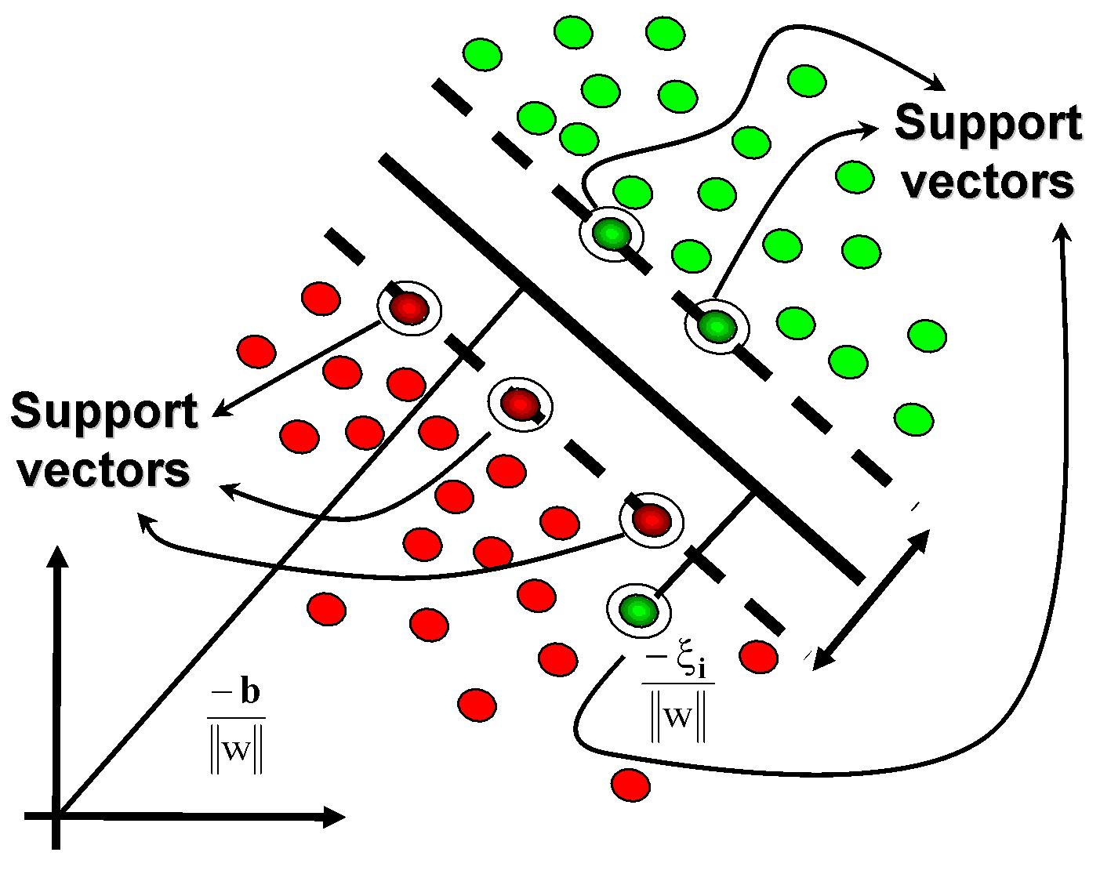
Terminology(5)
(SVMs)

Slide 10
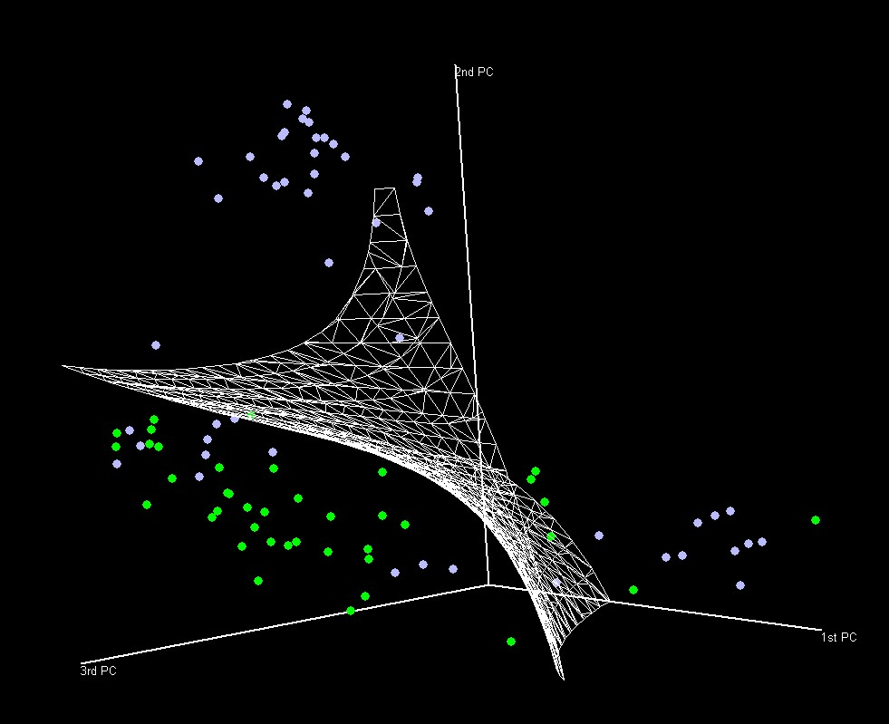
Terminology(6)
(SVMs)

Slide 11
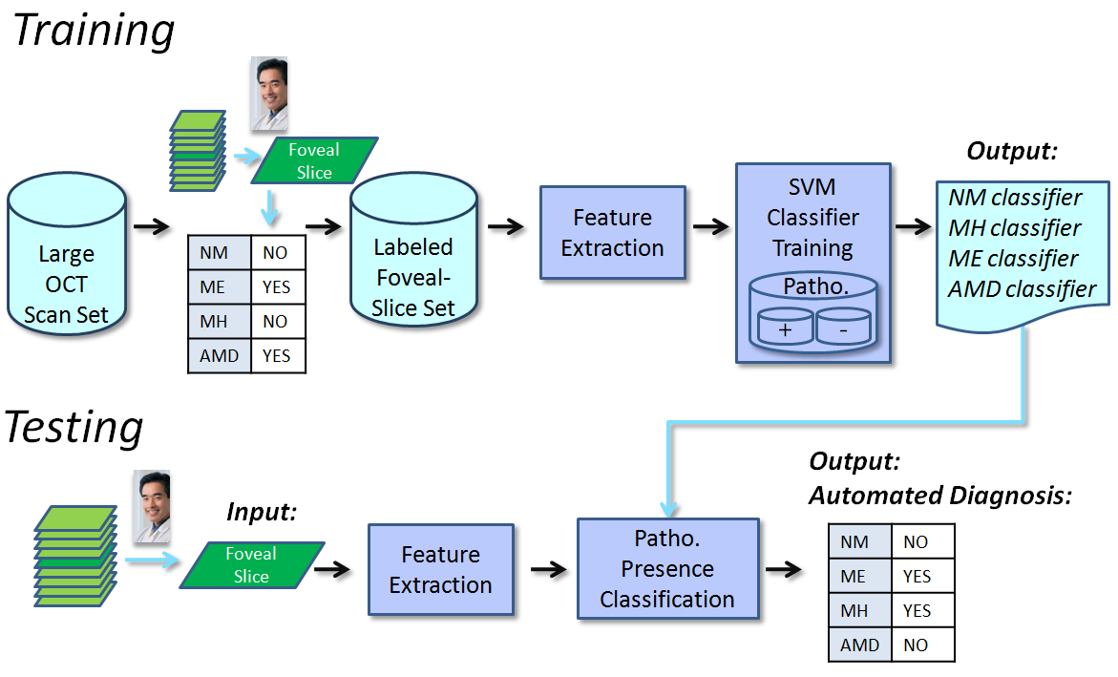
Terminology(7)
SVM

Slide 12
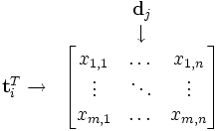
Terminology(8)
Bag-of-word model (BoW):representation used in NLP ,In this model, a text (sentence or document) is represented as an unordered collection of words, disregarding grammar and even word order.
Example :
Here are two simple text documents:
John likes to watch movies. Mary likes too.
John also likes to watch football games.
Based on these two text documents, a dictionary is constructed as:
{"John": 1, "likes": 2, "to": 3, "watch": 4, "movies": 5, "also": 6, "football": 7, "games": 8, "Mary": 9, "too": 10}
Representation of the document using the above dictionary lead us to the following matrix
[1, 2, 1, 1, 1, 0, 0, 0, 1, 1]
[1, 1, 1, 1, 0, 1, 1, 1, 0, 0]
The element at (i,j) is the word count (or,
frequency) of the i’th word in the j’th
document.

Slide 13
Problem : File fragment classification
● Files can be stored in a fragmented manner on the disk
● When file system information is missing or corrupted, carving files from file fragments requires some automated way of classifying file fragments according to file type

Slide 14
Related Work (1)
Author/year | # File type | Data set | Method used | Accuracy | critic
Calhoun and Coles(2008) | 4 | missing | linear discriminate analysis (Fisher, 1936) Shannon entropy (Shannon, 1948) | 88.3% | Fewer file type , can’t be generalized to real problem
Axelsson (2010) | 28 | Garfinkel et al. (2009) | k-nearest-neighbors , nearest compression distance | 34% | Higher entropy less accuracy
Conti et al. (2010) | 5 | Private data set | Shannon entropy, Hamming weight, Chi-square goodness of- fit, and mean byte value | Varying for different file | Does not work well in real data
Li et al. (2005) | 8 | Private data set | k-means clustering algorithm |  | Explicitly depend on the header file

Slide 15
Related Work (2)
Author/year | # File type | Data set | Method used | Accuracy | critic
Veenman (2007) | 11 | Private data set | histogram of the byte values (unigram counts), the Shannon entropy, and the algorithmic or Kolmogorov complexity | 45% | missing
Li et al. (2010) | 4 | Private data set | support vector machine based on histogram of the byte values(unigram) | 81.5% | Large file size used
Our paper | We will see later
Same as this paper

Slide 16
Related Work (3)
Issues we must car about :-
File type we used in the experiment.
We must report the classifier how it is perform in each different file type .
Insure that the training and testing set didn’t overlap
Omit the first file fragment , when create the sets.

Slide 17
Problem : File fragment classification
● Files can be stored in a fragmented manner on the disk
● When file system information is missing or corrupted, carving files from file fragments requires some automated way of classifying file fragments according to file type

Slide 18
Contribution
Applying supervised machine learning techniques from NLP (natural language processing) to file fragment classification.
● Experiments yield promising results

Slide 19
Data Set (1)
Derived from freely available Garfinkel corpus (govdocs1)
● Uniformly sampled files such that would have at least 10 files made up of at least 10000 file fragments, for each file type.
● Discarded first and last fragment of each file
[Calhoun&Coles '08; Conti et al. '10; Li et al. '10]
● Uniformly sampled 9000 fragments for each file
type to create data set .

Slide 20
Data Set (2) File Type
● Selected 24 well-known file types from among the most well-represented file types among govdocs1 files
● Including low entropy (e.g. text) and high entropy (e.g. compressed) files
● TODO: Develop rigorous methodology for selecting file types of forensic interests
Developed later in future work

Slide 21
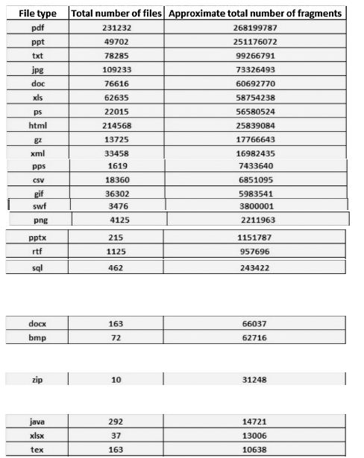
Data Set (3)File Type

Slide 22
Data Set(4) File fragment size
Generally, safe to assume file fragments are 512-bytes in size
● Without filesystem information, cannot safely assume larger size
● Smaller file fragments are harder to classify [Gopal et al. '11]

Slide 23
Features (1) : Unigrams and bigrams
● A unigram is a single byte within a file fragment
● A bigram is a pair of consecutive bytes within a file fragment
● Histogram of unigrams constitutes 256 features
[Li et al. '05; Veenman '07; Li et al. '10]
● Histogram of bigrams constitutes 256 ^2 features
[Gopal et al. '11]

Slide 24
Features (2) : Shannon entropy
● Measure of uncertainty associated with a
random variable [Shannon '48].
● Conti et al. ['10] found entropy of bigrams to be
effective for classifying file fragments.

Slide 25
Features (3) : Hamming weight
● Total number of ones divided by total number
of bits in file fragment [Conti et al. '10]
string | Hamming weight
11101 | 4
11101000 | 4
00000000 | 0
hello world | 11

Slide 26
Features (4): Mean byte value
● Mean value of all the bytes in a file fragment
[Conti et al. '10]
An average (Mean) is simply all the values of the bytes added together and then divided by the number of bytes in the fragment.
Sum(byte)/512 ??????

Slide 27
Features (5): Kolmogorov complexity
Minimum amount of data needed to specify a file fragment [Kolmogorov '65; Lempel&Ziv '76]
Can be approximated by compressing the file
fragment (e.g. with bzip2 algorithm) [Seward '01; Veenman '07]
ab 32
For example :
abababababababababababababababababababababababababababababababab
4c1j5b2p0cv4w1x8rx2y39umgw5q85s7traquuxdppa0q7nieieqe9noc4cvafzf
64 char

Slide 28
Features (6): NLP features
Average closeness between bytes (i.e. the average distance between consecutive bytes)
Longest contiguous streak of repeating bytes.
How

Slide 29
Experiments I
● Three experiments (k = 1000, 2000, 4000)
● Uniformly sample k file fragments for each file
type to produce data set of 24・k file fragments
● Randomly partition data set into training and
testing sets (in, roughly, 9-to-1 ratio)
● Ensure fragments from the same file do not
appear in both the training and testing sets

Slide 30
Experiments II
● Train libsvm [Chang&Lin '11] on training set
and test on testing set
● Repeat ten times, each time resampling the 24・k file fragments

Slide 31
Experiments III
● We used linear kernel [Li et al. '10], default parameters, and did not scale the feature vectors
● Optimal parameters and scaled feature vectors should yield better results
● SVM optimized for linear kernel (e.g. liblinear)
can dramatically decrease training time

Slide 32
Result 1

Slide 33
Result 2
● Prediction accuracy of 49.1%
● Baseline is 1/24 ≈ 4.17% (random chance)
● Axelsson ['10] achieved 34% on 28 file types
● Veenman ['07] achieved 45% on 11 file types
● Gopal et al. ['11] achieved about 33% using
macro-averaged F1 metric
● Using same metric, our accuracy is 48.0%

Slide 34
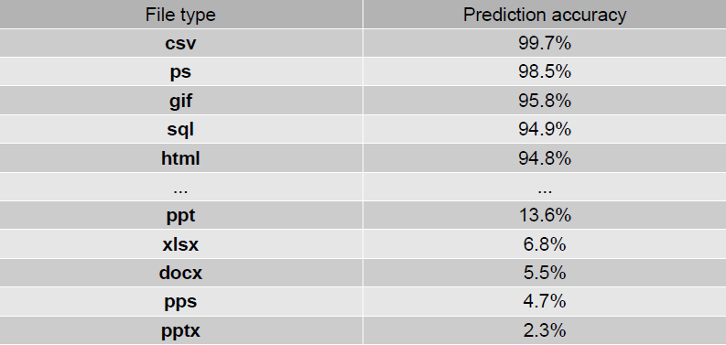
Result 3
Better Accuracy for Text file
Poor accuracy for other file type

Slide 35
Result 4
Best performance on low entropy file
fragments, and worst on high entropy file fragments, which agrees with previous work [Conti et al. '10; Li et al. '10]

Slide 36
Result 5 (Confusion Matrix)
In the field of artificial intelligence, a confusion matrix is a specific table layout that allows visualization of the performance of an algorithm, typically a supervised learning one.
Each column of the matrix represents the instances in a predicted class.
each row represents the instances in an actual class
it easy to see if the system is confusing between the classes.

Slide 37
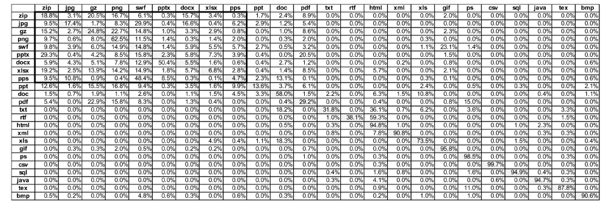
Actual class
Result 6 (Confusion Matrix)
Predicted Class

Slide 38
Some more (preliminary) findings
Histogram of bigrams provided most significant contribution to classification accuracy.
Histogram of unigrams, contiguity, and Hamming weight were also important (but to a much lesser extent).
Take this with grain of salt

Slide 39
Conclusion & Future work
Need to focus efforts on classifying high
entropy file fragments
Consider applying various machine learning
boosting techniques, such as AdaBoost
[Freund&Schapire '97]
Consider first classifying according to broadcategories (e.g. Encrypted vs. Machine Code vs. Text) [Conti et al. '10], and using a separate specialized classifier within each category

Slide 40
Flaws
Not clear how it is different from the previous work. They said that they used more file types and different data set).
They didn’t explain well the features vector they used .also how these affect the performance of the algorithm. Which is the most important issue in the experiment.
Some times they didn’t mention important information from the literature which is important to make it fair for the comparison with the others.
they didn’t apply the other techniques to the same data .
It is appear that there is no motivation in there work. Just they try different techniques and claim that they have promised result !!!!!!!!!!!!!!!!!!!!!!!!!!!!!!!!!!

Slide 41
Thank you

Slide 42
Questions

