Slide 1
Software Forensics
Extending Authorship Analysis
Techniques to Computer Programs
Presented by:
Mohammed Younus Siddiqui
201103270

Slide 2
Outline
Introduction
Source Code
Software Forensics
Authorship Analysis
Motivation
Practice
Different Types of Code
Case Studies
Internet Worm
WANK and OILZ Worm
Conclusion
Future Work

Slide 3
Introduction

Slide 4
Basic Idea
When programmers program, they unwittingly (perhaps not) leave “fingerprints” in the content, structure, style and other elements that can be used to correctly identify the author(s) at later time.
When programmers compile, the tools they use leave “fingerprints” in the resulting executable code that can be used to identify those tools and the environment in which they were used.

Slide 5
Definition
Linguistics
The study of the nature, structure and variation of language, including phonetics, phonology, morphology, syntax, semantics, sociolinguistics and pragmatics.
Software Metrics
A set of repeatable measurements of certain aspects of a software.
Programming Language
A formal, structured, English-like language in which computer programs are written.

Slide 6
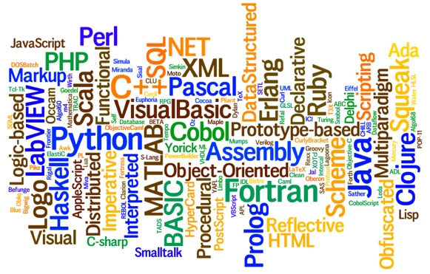

Slide 7
Programming Language
Differ in terms of
Generation
the time that they were devised and reflecting their level of abstraction
Type
such as procedural, declarative, object-oriented, and functional
Just like text, it can also be examined from a forensics viewpoint

Slide 8
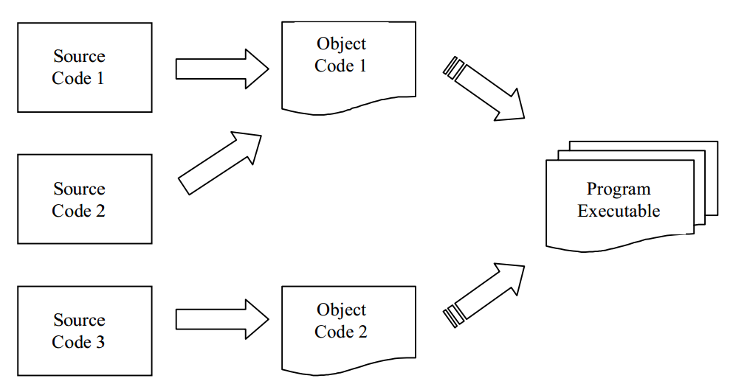
Programming Process

Slide 9
Source Code
The "blueprint" of software.
The human-readable form of a computer program.
It is produced by programmers or generated by programs.
It is written in a computer programming language.

Slide 10
Source Code
Source code is more formal and restrictive than spoken or written languages.
However, computer programmers still have a large degree of flexibility when writing a program to achieve a particular function

Slide 11
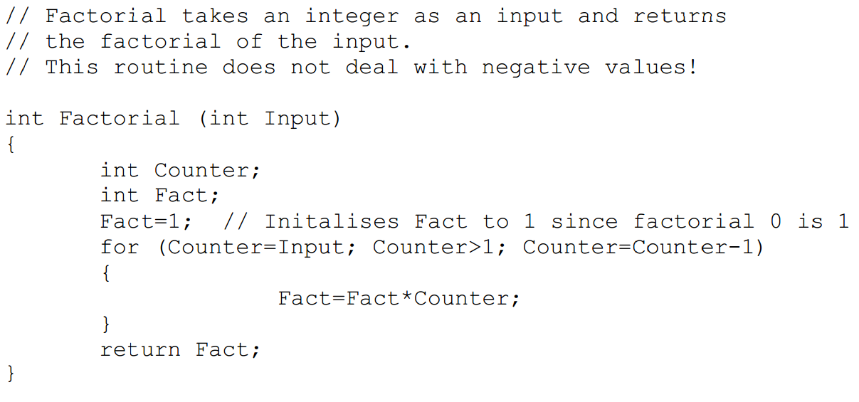
Source Code 1:
Source Code 2:

Slide 12
Source Code
The stylistic differences include the use of comments, variable names, use of white space, indentation, and the levels of readability in each function.
These fragments are obviously far too short to make any substantial claims.
They do illustrate the ability for programmers to write programs in a significantly different manner to another programmer.

Slide 13
Flexibility
Flexibility includes:
manner in which the task is achieved
the way that the source code is presented in terms of layout
the stylistic manner in which code is written
Other flexibilities include selecting:
the computer platform
programming language
compiler
text editor to be used

Slide 14
Applicability for Forensics
Features of a computer program (algorithm, layout, style, and environment) can be specific to certain programmers or types of programmer.
Particular combinations of features and programming idioms can make up a programmer’s problem solving vocabulary.
Therefore, computer programs contain some degree of information that provides evidence of the author’s identity and characteristics.

Slide 15
Software Forensics

Slide 16
Definition
It refers to the use of measurements from software source code, or object code for some legal or official purpose.

Slide 17
Authorship Analysis
The four principal aspects of authorship analysis that can be applied to software source code, and that are of interest to the discipline of software forensics, are as follows:
Author discrimination
Author identification
Author characterisation
Author intent determination

Slide 18
Author Discrimination
Task of deciding whether some pieces of code were written by a single author or by different authors.
Calculation of some similarity between the two or more pieces of code

Slide 19
Author Identification
Determine the likelihood of a particular author having written some piece(s) of code
Usually based on other code samples from that programmer. Example: a virus

Slide 20
Author Characterization
Determining some characteristics of the programmer
Example: particular educational background due to the programming style and techniques used

Slide 21
Author Intent Determination
Determine whether code that has had an undesired effect was written with deliberate malice, or was the result of an accidental error
Can be extended to check for negligence

Slide 22
Additional Sources of Evidence
Also can analyze object code/executable code
By decompiling it into source code with some information loss (optimization)
Information obtained: compiler and/or platform used, etc.
In general source code is the better source of evidence

Slide 23
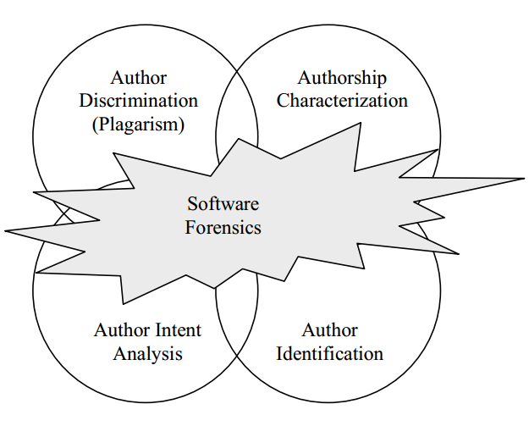
Software Forensics

Slide 24
Motivation for Software Forensics
Threats: virus, worms, Trojan horses, logic bomb, plagiarism (theft of code)
Malware infection continued to be the most commonly seen attack (CSI survey 2010)
Software crimes continued to be tackled in an ad hoc manner
Complete and well-defined field is required, with its own techniques and tools

Slide 25
Practice of Software Forensics
Psychological analysis of code can be performed
A more scientific approach: quantitative and qualitative measurements made on computer program source code and object code
automatically extracted by analysis tools
calculated by an expert
using some combination of these two methods.

Slide 26
Example of Metrics
The number of each type of data structure used can be indicative of the background and sophistication of a program author.
The cyclomatic complexity of the control flow of the program can show the characteristic style of a programmer and may suggest the manner in which the code was written.

Slide 27
Example of Metrics
The quantity and quality of comments in the code can provide evidence of linguistic characteristics
The types of variable names used within the program can provide clues as to background and personality.
The use of layout conventions give information about the programmer’s personality.

Slide 28
Analyzing Executable Code
Useful Features
Data structure and algorithm
Compiler and system information
Programming skills and system knowledge
Choice of system calls
Errors

Slide 29
Analyzing Source Code
Language
Formatting
Special features
like conditional compilation construct specially those involving initialization and declaration files
Comment styles
Variable names
Spelling and grammar
Use of language features

Slide 30
Analyzing Source Code
Scoping
ration of global to local identifiers)
Execution path
Ex: code fully functional but never
reference by any execution path)
Bugs
Metrics
software metrics: number of lines of code per function, number of blank lines

Slide 31
Final Step of the Forensic Analysis
Once these metrics have been extracted, a number of different modelling techniques, such as cluster analysis can be used to derive models
The form of the model, the technique used, and the metrics of use all depend greatly on the purpose of the analysis and on the information available

Slide 32
Use of Software Forensic
Software Forensics can be, and has being used for a number of diverse tasks
More Common Applications
Areas of malicious code analysis
Detection of plagiarism (code theft)
Less common areas
psychological studies of programming
assessing source code for quality
identifying authors of code for maintenance purposes

Slide 33
Issues
the issue of how well an individuality can be hidden, or mimicked
whether or not authorship can be sufficiently accurately recognised in itself, even without masking attempts.
Whether or not there is in fact sufficient information available using these techniques to provide adequate authorship evidence for use within a legal context

Slide 34
Case Studies

Slide 35
Analysis of Malicious Code
What does the code do?
Who wrote the code?
When was the code written?
What is the intent of the code?

Slide 36
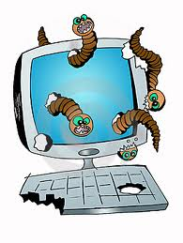
Internet Worm (Spafford, 1989)
Written by Robert Morris
Released onto the Internet on November 1988
Spafford’s (1989) analysis of the Internet Worm is based on three separately reversed-engineered versions of the worm.

Slide 37
Observations
Not well written and contains many errors and inefficiencies.
Not portable.
Not checked using lint.
Contains little error-handling behaviour
author was sloppy and performed little testing
worm’s release was premature.

Slide 38
Observations
Structures used are all linked lists that were inefficient
indicated a lack of advanced programming ability and/or tuition.
Contains redundancy of processing.
The code seemed to have been written over a long period of time.

Slide 39
Observations
A section that performs cryptographic functions is exceptionally efficient and provides functionality not used by the worm.
This does not appear to be written by the author of the rest of the worm.

Slide 40
The WANK and OILZ worms
In Longstaff and Schultz (1993) the WANK and OILZ worms were studied.
Released in 1989.
written in DCL.
Focussed on attacking NASA and DOE systems.
The WANK worm is 785 lines long and exhibits structural coding.
Three distinct authors worked on the system.

Slide 41
Author One
Academic style of programming
Descriptive and lower case variable names
Flow based on variables, gotos, and subroutines and is complex
High level of understanding
Experimentation rather than malicious intent

Slide 42
Author Two
Malicious code with hostile intent
Use of profanities
Capitalisation
Simple programming style

Slide 43
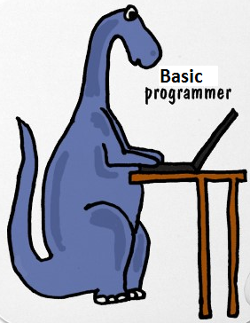
Author Three
Combined the others’ code
Mixed case
Non-descriptive variable names
Simple coding that resembles BASIC

Slide 44
Conclusion
The fundamental assumption of software forensics is that programmers tend to have coding styles that are distinct, at least to some degree
As such these styles and features are often recognizable in source code analysis
Software Forensic Goal: analyzing computer programs authorship for legal reasons

Slide 45
Future Work
The authors are currently developing a toolkit called IDENTIFIED (Integrated Dictionary-based Extraction of Non-language-dependent Token Information for Forensic Identification, Examination, and Discrimination)
Perform automatic extraction of a wide variety of metrics
Contains modules for case based reasoning, discriminant analysis, and other analysis techniques.

Slide 46
Future Work
Formally defined metrics that can be used for software forensic
Statistical models of certainty and combining evidence for source code authorship analysis
Determining the legal issues that would be involved in using such evidence.

Slide 47
Thank you for Listening!
Any Questions or Comments or Ideas or Complaints?

