Slide 1
3WSDS 3-Way Secure Data Splitting Supervisor: Dr. Talal Alkharobi
Abdul-Mohsin AL-Faraj (201081340)
Hamed Al-Mehdhar (200925210)

Slide 2
Outline
What is 3WSDS?
Project Specifications:
User requirements.
Technical specifications.
Project Usage Guidelines.
Engineering Design:
Design Decisions.
Architecture.
Sub-function identification.
System Architecture.
Component Design and Implementation.
System integration.
Issues.
Engineering Tools and Standards.
Questions.

Slide 3
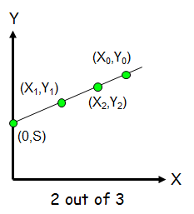
What is 3WSDS?
3WSDS is based on (2 out of 3) secret sharing scheme.
(2 out of 3) secret sharing scheme drives from the fact that two points determine a line.
The secret!

Slide 4
Project Specifications:
User requirements:
The device is connected to the PC through USB for power.
3 USB ports to connect the flash drives, where secret shares will be distributed to and reconstructed from.
Fourth USB port to connect the flash drive containing a file to construct shares form, or to write a reconstructed file back to.
A button to perform partitioning of the original file to 3 secret shares, and another button to reconstruct the original file.
An indicator which shows the start, progression, and end of a function when its button is pressed.

Slide 5
Project Specifications:
Technical specifications:
Device is powered up by connecting through USB port to a PC or by having an internal battery.
3 USB ports to connect the flash drives, where share builds will be distributed to and reconstructed from.
Fourth USB port to connect the flash drive containing the file to construct shares for, or to write a reconstructed file back to.
A partitioning button is pressed to partition the original file in main flash drive to 3 different secret shares which are distributed to the other three flash drives (following a 2 out of 3 secret share scheme).
A reconstruction button is pressed to reconstruct the original file in main flash drive by reading 2 out of 3 of the secret shares available in the other three connected flash drives.
When any of the buttons is pressed, an LED will light to indicate ongoing function, it will be off when the function ends.

Slide 6
Project usage guidelines:
The flash drive containing the main file should be connected to port 0.
The flash drive connected to port 0 must contain a file (name.txt) containing the name of the file to be partitioned. 3 secret shares named (WSDS.txt) will be constructed and written to the flash drives connected to ports 1,2 and 3, then the main file will be deleted from the original flash drive (only for partitioning function).
after doing the above steps, any of the 2 function buttons can be pressed were an LED will turn ON until the completion of that function and it will go off after that. The flash drives CAN’T be removed while the LED is on.

Slide 7
Engineering Design:
Design Decisions:
Use a microcontroller to do the logic of design .
choosing between different microcontrollers. (Arduino)
choose a USB host board. (hobbytronics USB Shields)
Changing the design of the project .(use a 4th flash drive)

Slide 8
Architecture:
Sub-function identification:
Partitioning Sub Function:
This sub function is responsible for constructing and distributing 3 different shares of the main file.
Y1=(M*X1+s)%256
Reconstruction Sub Function:
This sub function is responsible for the reconstruction of the original file using 2 out of 3 of the distributed secret shares.
M=(Y2-Y1)/(X2-X1)
S=(Y1-M*X1)%256 (if S is <0, add 256)

Slide 9
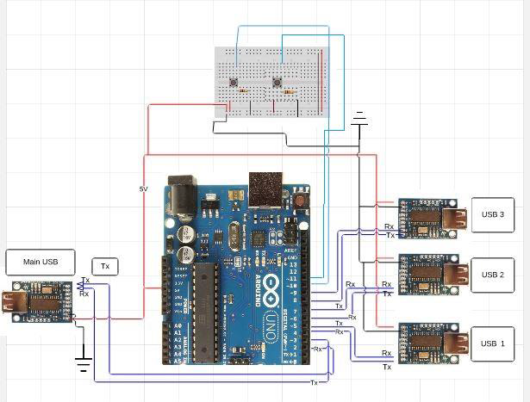
Architecture:
System architecture :

Slide 10
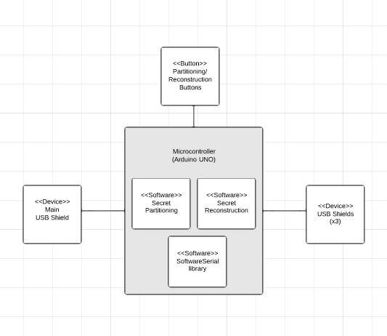
Architecture:
System Components:

Slide 11
Architecture:
Interfaces between hardware components and how they are connected to each other:
The Arduino is connected to the USB host shields using TTL serial communication interface.
Ex, USB port 0 is connected to pins 2(RX) and 3(TX).

Slide 12
Component Design and Implementation:
Off-the-shelf hardware and software components:
Arduino Uno.
USB host shields.
Buttons.
SoftwareSerial Library.
Custom software components:
Secret Partitioning code.
Secret Reconstruction code.

Slide 13
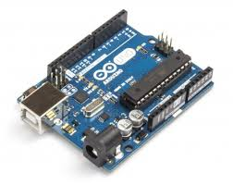
Off-shelf hardware and software components
Arduino Uno
Do the processing part of the design
Project code is uploaded to the Arduino
Buttons
Partitioning and reconstruction buttons
Each button will trigger respective sub function.

Slide 14
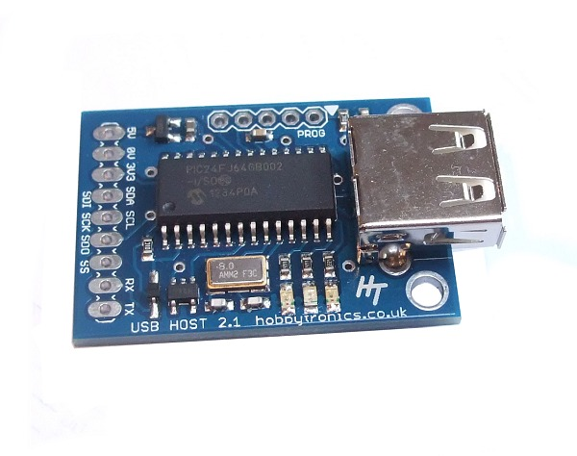
Off-shelf hardware and software components
USB host shields
Interface between the Arduino Uno
and the USB flash drives
Preinstalled flash drive software,
manufactured by HobbyTronics
Communication with Arduino via TTL serial interface, ASCII characters
Reads different commands , terminated by carriage return character (“$read filename linenumber”)
Silent (microcontroller) and terminal (PC) mode

Slide 15
Off-shelf hardware and software components
SoftwareSerial library
used to make digital pins act as a Serial TTL RX and TX pins
Create object example: SoftwareSerial mySerial(2,3) //RX , TX
mySerial.write() is used to write to the serial interface
mySerial.read() is used to read from the serial interface

Slide 16
Custom Software Components
Secret Partitioning Code
Uploaded to Arduino as part of the main code
Code is triggered when the partitioning button is pressed
Implements the partitioning sub function
Psuedo code written before actual code
Secret Reconstruction Code
Uploaded to Arduino as part of the main code
Code is triggered when the reconstruction button is pressed
Implements the reconstruction sub function
Psuedo code written before actual code

Slide 17
System integration :
Testing and debugging:
Testing of the USB host shields:
Tested to read and write from a file using a single shield.
Tested different commands of USB host shield.
Tested to copy a file from a flash drive to another flash drive.
Tested copying files from 1 flash drive to 3 flash drives

Slide 18
Issues
throughout the progressions of our work we faced a lot of issues and challenges such as:
The first issue we faced was how to communicate with flash drives using an Arduino.
The second issue we faced was how to make the Arduino act as a flash drive
The third issue we faced was while testing the USB host shields, one shield stopped working and another one was not reading and writing properly, had to make prototype on 2 USB ports

Slide 19
Issues
The fourth kind of issues were experience in testing the USB host shields:
Incorrect reading and writing from and to files in flash drive.
At a point, we couldn’t communicate with the USB shields so we changed the Arduino and it worked.
Reading commands sent concatenated with read lines, mySerial.flush()
A lot of faced problems throughout the progression of writing our code

Slide 20
Limitations and constraints:
The flash drive shouldn’t be removed while a function is being performed, or else the flash drive would be damaged.
The name of the file to be partitioned, have to be saved in the first line of a text file called “name.txt”.
The file name is assumed to be provided correctly, if not, the function of the device won’t trigger.
The device can’t show nor it can know the available size of flashes. So it is assumes that there is enough size.
The device function speed is relatively low since it is limited by the processing of the Arduino and the USB host shields and also by the embedded delays in the code to give enough time for the shields to process data and commands.

Slide 21
Engineering Tools and Standards
Available tools chosen and why:
Arduino IDE to program and compile our code:
We chose to use Arduino IDE because it is the Arduino open-source environment makes it easy to write our code and upload it to the Arduino UNO.

Slide 22
Engineering Tools and Standards
Used standards:
USB protocol:
The protocol the shields would use to communicate with the flash drive.
TTL protocol:
The serial TTL interface is the interface between the USB shields and the Arduino UNO.

Slide 23
Demo Video

Slide 24
Questions?

