Slide 1
Tracking Employee
By:
Abdullah ALGhaith
Mohammad AL-Hajji

Slide 2
Table of Content
- Introduction
- Problem Statement design
- Engineering tools & standards
- Engineering
-Hardware
-Software
- Issues
- Teamwork
- Conclusion

Slide 3
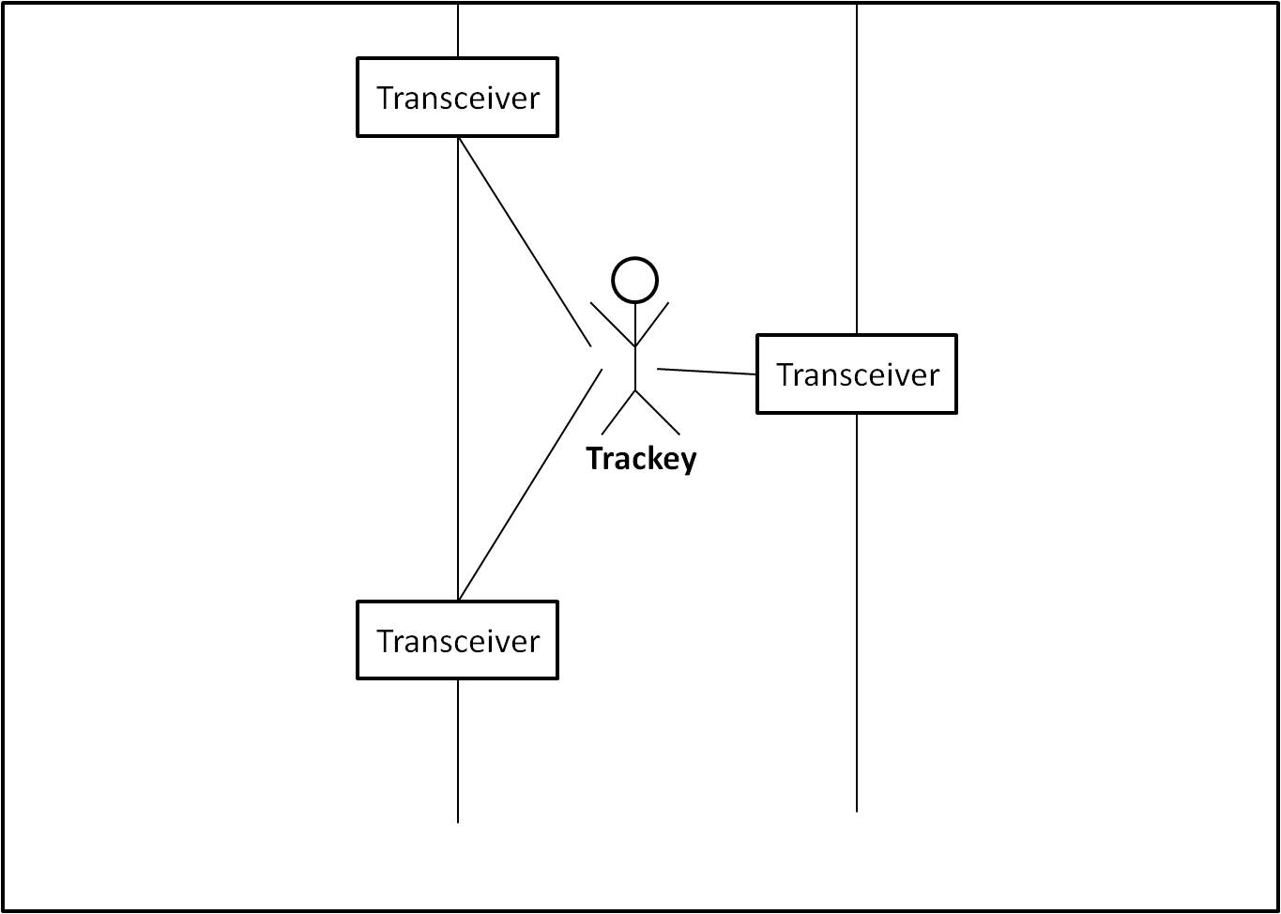
Introduction

Slide 4
Problem Statement
http://jonbowermaster.com/blog/wp-content/uploads/2009/04/abc_c_fiona_stewart_2.jpg
http://www.thehindu.com/multimedia/dynamic/00796/01BGFIRECITY_796676f.jpg

Slide 5
Engineering tools & standards
- Comparisons.
Microcontroller
Atmel ATMEGA128RFA1 | Arduino
Embedded Radio | Extra shield
Cheap | Expansive

Slide 6
Engineering tools & standards
- Comparisons.
Communication standard
IEEE802.15.4 | RFID
Works within buildings | Line of site only
Cheap | Expansive

Slide 7
Engineering tools & standards
- Comparisons.
Algorithm
Trilateration | Triangulation
Used in small Area | Needs a large area

Slide 8
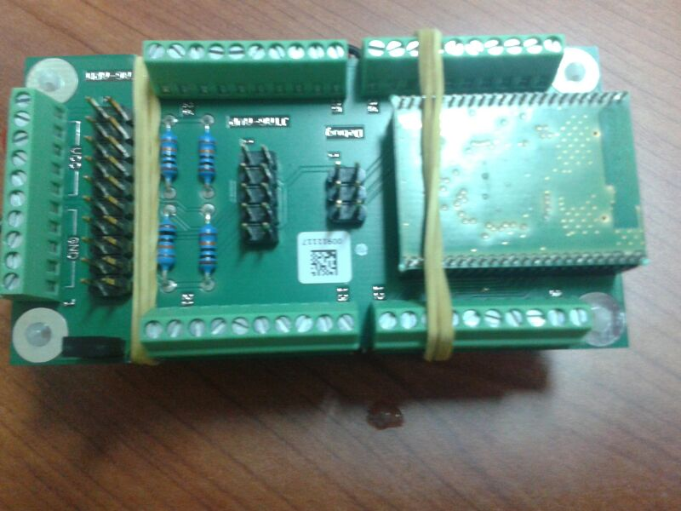
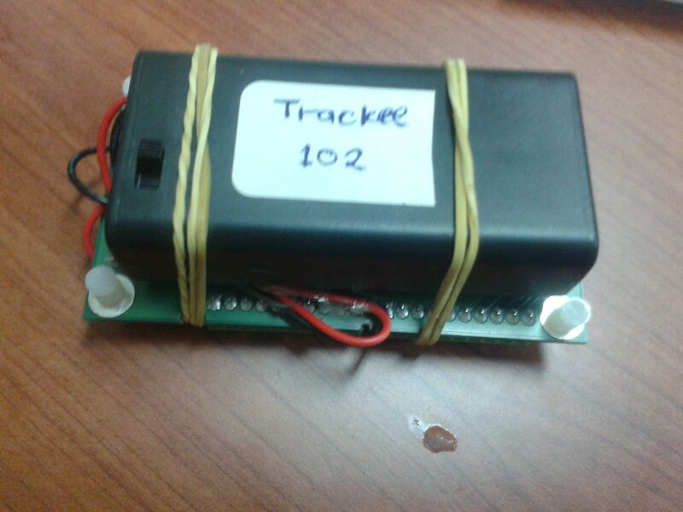
Engineering Design
Hardware part
Trackee
Atmel ATMEGA128RFA1

Slide 9
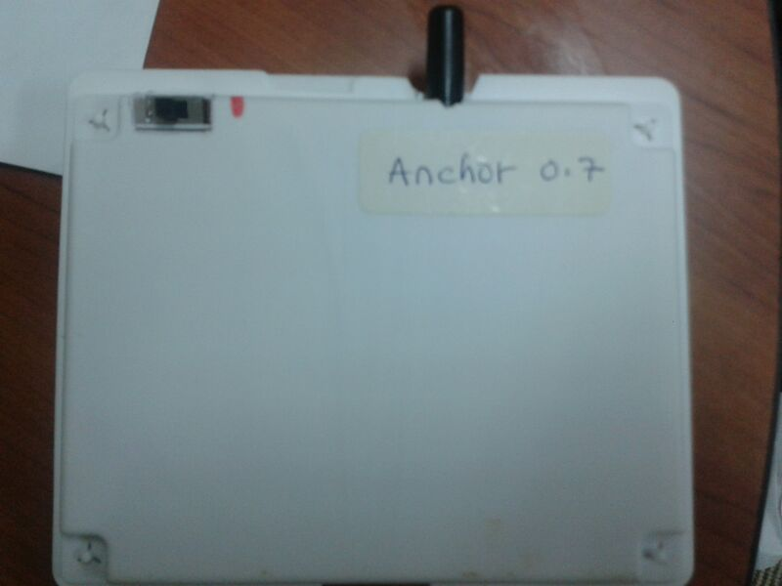
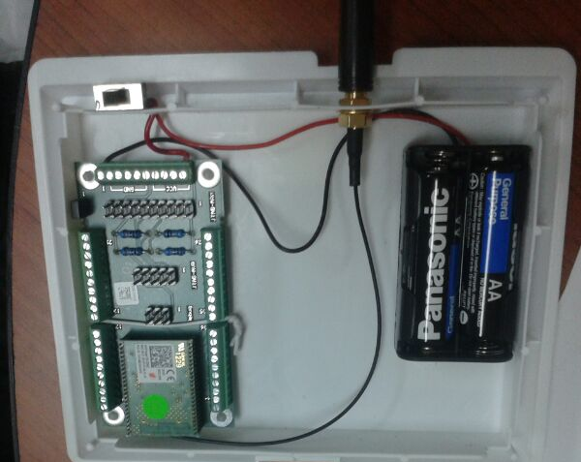
Engineering Design
Hardware part
Transceiver
Atmel ATMEGA128RFA1

Slide 10
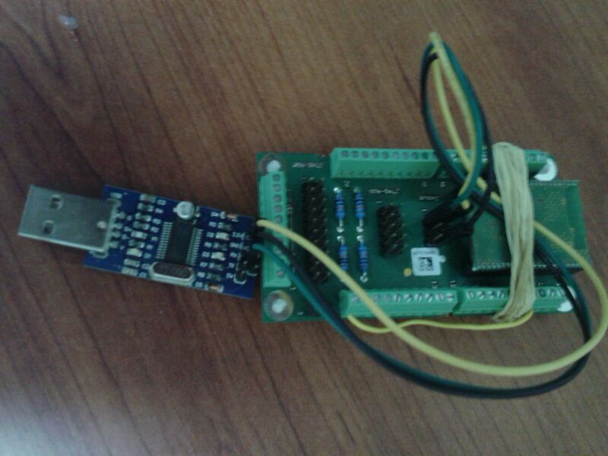
Engineering Design
Hardware part
Gateway
Atmel ATMEGA128RFA1

Slide 11
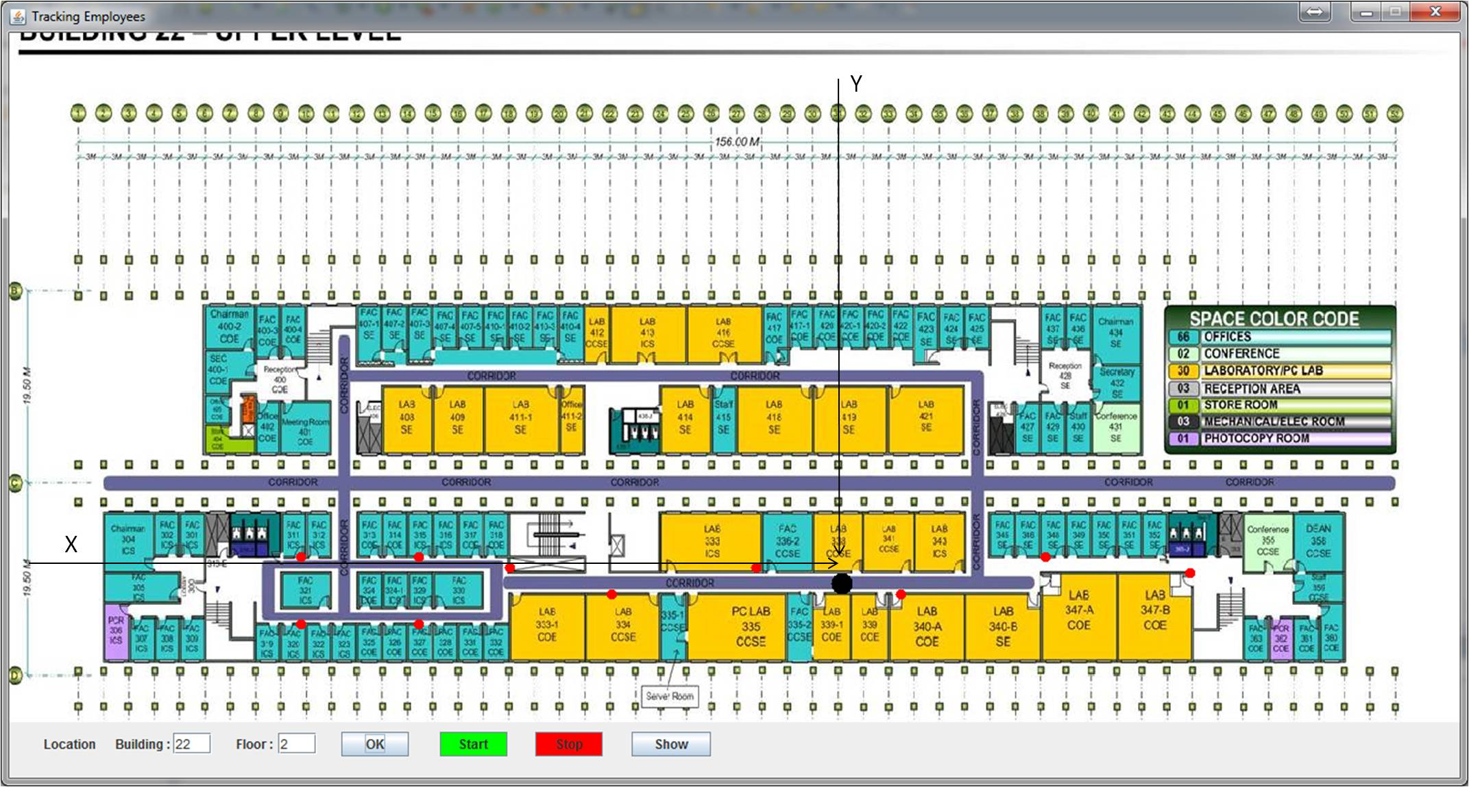
Engineering Design
Software part
GUI ( Graphical User Interface)
Java

Slide 12
Engineering Design
Software part
Database My SQL

Slide 13
Engineering Design
#, Trans0, Trans1, Tr0, Tr1, Serial#, RSSI, LQI, #

Slide 15
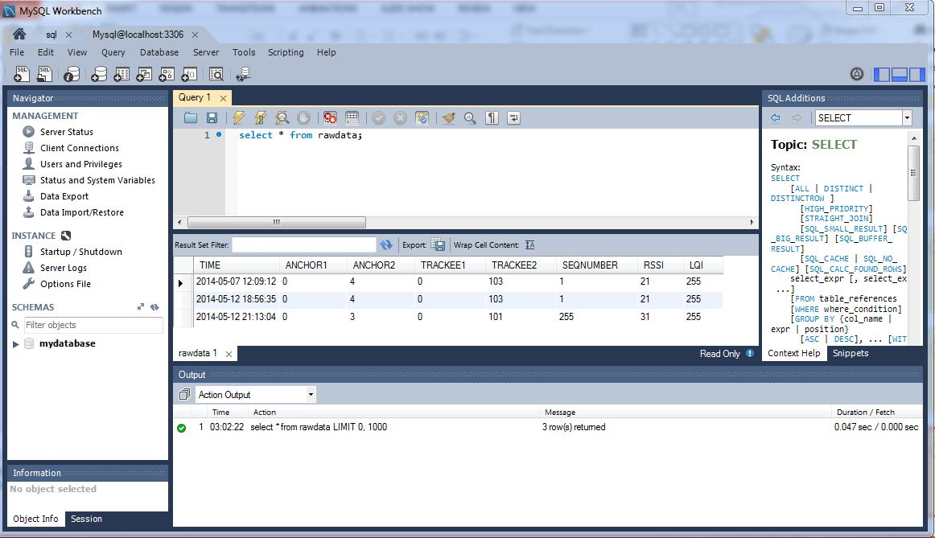

Slide 16
Engineering Design
Design decision

Slide 17
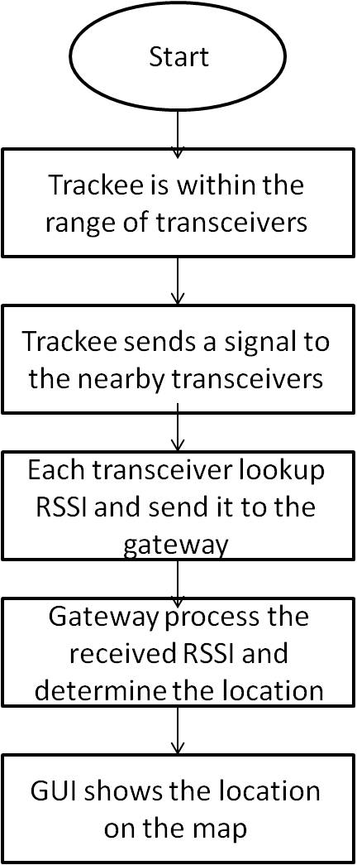
Engineering Design
How does The System work ?

Slide 18
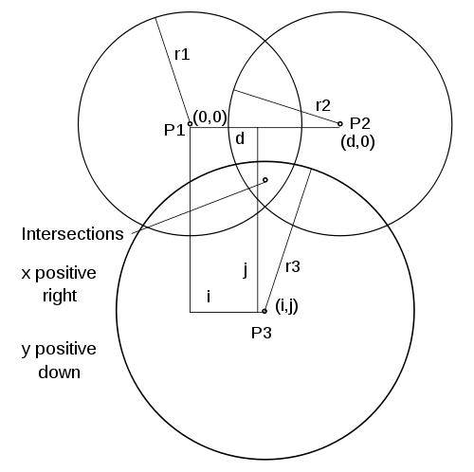
Trilateration Algorithm

Slide 19
Energy Detection (ED)

Slide 20
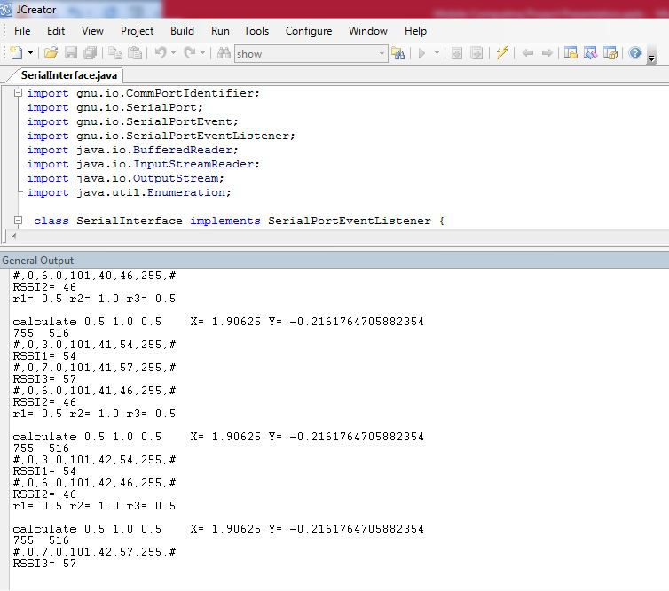
Serial Interface
#, Trans0, Trans1, Tr0, Tr1, Serial#, RSSI, LQI, #

Slide 21
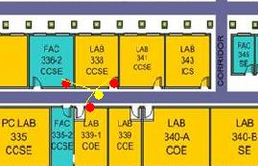
Example

Slide 22
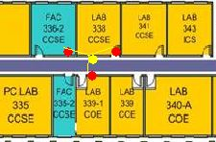
Example

Slide 23
Issues
- RSSI values alternating.
- GUI inserting points
- Battery life effective.

Slide 24
Teamwork
Abdullah ALGhaith
GUI Interface Design
Mohammad AL-Hajji
Microcontrollers and Serial Communication
Cooperate in: RSSI measurement, Algorithm and Database

Slide 25
Conclusion
Questions ??

