Slide 1
Senior Project Discussion
Handicapped Parking Spots
Coordinator: Dr. Ahmad Khayyat
Supervisor: Dr. Kamal Chenaoua
Team Members: Mohammad Makkawi
Rami Rustom
Yazan Hlayel

Slide 2
Outline
Introduction
Background.
Problem Statement.
Marketing Requirements
Design and Architecture
Logical Design
Subsystems
Design Decisions
Technical Specifications
Component and Interfacing
Implementation
Sub-Systems Implementation
Integration
Issues
Limitations
Conclusion

Slide 3
Introduction
The Problem
Handicapped parking abuse.
Affects 72% of handicapped.
How big is it ?
Many attempts to solve the problem.
APPs to report abusers.
Why ?
“I feel there are too many parking spaces reserved for the handicapped”
“I feel many people who have handicapped parking license do not really need them”

Slide 4
Current Solutions
Issue a handicapped permit from “The Ministry of Social Affairs”.
Guard to check the parked cars.
Remote controlled gates.

Slide 5
Proposed Solution Requirements
Allow only eligible people to use the parking spot.
Show the number of empty handicapped spots at the entrance of the parking.
Ability to issue temporary permits to use handicapped spots.

Slide 6
Design and Architecture

Slide 7
Logical Design
Controller
Blocking
Counting
Car
Detector

Slide 8
Subsystems
Identification
Reader
Tag
Blocking
Controllable Gate
Counting
Controller
Screen

Slide 9
Design Decisions
Identification sub-system
License Plate Recognition
Passive RFID
Active RFID
QR code
Blocking method
Parking space guard
Electro-Hydraulic Spike Barrier
Electro-hydraulically Blocking Bollards
Parking Post
Passive RFID
Hard to forge (secure).
Cheap.
Easy to use.
Has security (challenge and response).
Parking space guard
Integrated radio receiver
Handheld radio transmitter
solar technology (outdoor)
one way blocking (with sensors)

Slide 10
Design Decisions
Controller
Arduino
Raspberry pi
Atmel
Arduino
Developer friendly
Plenty of digital pins
Availability in the market
Accessories

Slide 11
Technical Requirements
MAX 1KB Passive RFID tags issued for handicapped people.
The tag contains information about the user and expiration date.
RFID antenna with a range of ~6 meters.
Blocking arm to secure the spot.

Slide 12
Component
Identification
UHF RFID Reader
UHF RFID Antenna
UHF RFID Tag
Counting
Arduino Mega 2560
TFT Display Screen
Blocking
Grove Relay
The car radio antenna

Slide 13
Interfacing
Reader to Tag
RF signals
Reader to Arduino
digital signal
Arduino to TFT Display
8 digital signals
Arduino to Relay
digital signal

Slide 14
Implementation
Sub-Systems Implementation
Identification and Authentication
Blocking
Counting
Integration
Issues
Limitations

Slide 15
Identification
RFID
What is it ?
Uses
Terminology
RSSI
RAPID

Slide 16
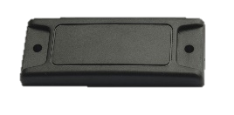
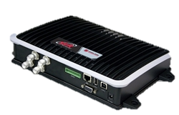
Identification
Events :
Tag Arrive
Tag Depart (3 s)
Tag Report

Slide 17
Identification
Tag Arrive
Authenticate Tag ID
Authenticate Tag Expiration
Value
Signed Value
Add to “Monitor” list.
 | 1 | 2 | 3 | 4 | 5 | 6 | 7 | 8
1 | Tag Signature (0x0000FFFF) |  |  |  | Tag is Local or Public (0000FFFF OR FFFF0000)
2 | Owner ID |  |  |  | Owner mobile number
3
4
5 | Long Value (Issue Time)
6 | Expiration Time (Signed)
7
8 | Long Value for (Expiration Time)

Slide 18
Identification
Tag Report
If tag is inside “Monitor” list.
Check the distance (RSSI)
Insure the tag isn’t moving.
Make decision (Open/ Close)

Slide 19
Identification
UHF tag (865-928) MHz.
64 Bytes memory.
Works in high temperature.
Orientation-independent.
Works with/around metal.

Slide 20
Identification
Testing Tags Orientation

Slide 21
Identification
Testing Tags Orientation

Slide 22
Identification
=AVERAGE(INDEX(A:A;1+20*(ROW()-ROW($B$1))):INDEX(A:A;20*(ROW()-ROW($B$1)+1)))

Slide 23
Implementation
Sub-Systems Implementation
Identification and Authentication
Blocking
Counting
Integration
Issues
Limitations

Slide 24
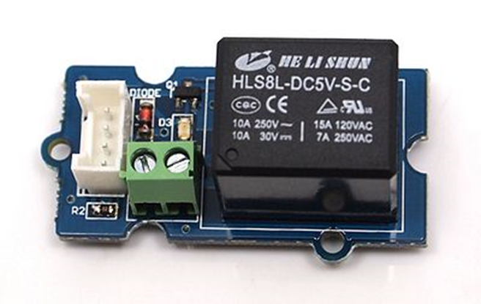
Blocking system
Black
Ground
Red
12v
White
Relay

Slide 25
Counting system

Slide 26
Control code
Include TFT display library
Define the TFT display pins
Define the TFT display
Define all the needed variables
setup{
Define the pin modes for input and output
Define the default value for each output pins
current value (cv) = opposite the signal coming from the reader
Write the initial value on the screen
}
loop class {
Write the new value on the screen
New value (nv) = signal coming from the reader
If cv != nv {
Check the coming signal twice with a 5s delay in between
Close or open the gate based on the signal
Refresh the counter
Write the new value on the screen
Cv = nv
}
}

Slide 27
System integration

Slide 28
Issues
Running the code on the reader.
Digital I/O not working
Buying the blocking device
Building the blocking device
Choosing the representative device
Refreshing the text on the TFT screen

Slide 29
Limitations
TFT screen library
the specifications of the RFID reader
digital I/O ports in the RFID reader
Numbers of supported antennas.

Slide 30
Conclusion
Developing applications by utilizing RFID technologies.
Using Arduino with enterprise devices and tools.
Controlling high voltage devices with a low voltage signals using relays.
Using third-party libraries to perform specific tasks and enhance the output.

