Slide 1
Smart Campus
Ali Alhussaini
Sultan Alotaibi

Slide 2
Outline
Project Background
Motivation
Technical Requirements
System Design:
Design Decisions
Three Tier Architecture
Component relation
Implementation
Demo
Issues

Slide 3
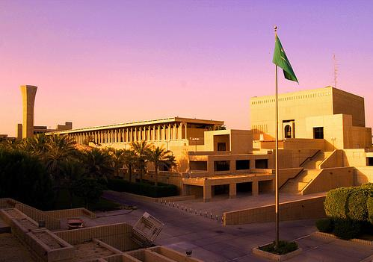
Project background
To design a smart campus that has the following features:
Non-invasive.
Convenient.
To be Modular.
Efficient.

Slide 4
Motivation
Motivation behind the project is to eliminate the following:
Lack of infrastructure utilization.
Wasted time, and thus money.
Human error.
Identity fraud.
Inconvenience.
Lack of real time information.

Slide 5

Pilot service
For the prototype, we need to implement an “Auto attendance” service using image detection and facial recognition.
This is achieved by using OpenCV library, maintained by Intel.

Slide 6
Technical requirements
No false positives
High detection Accuracy (at least 90%)
Bandwidth efficient.
Modularity.

Slide 7
System Design
System components:
Hardware:
Raspberry Pi & Raspberry pi camera module.
Software:
Image detection.
Image recognition.
Database
Web server
Attendance Software.

Slide 8
Design Decisions
Raspberry pi:
This component has a full OS which eliminates the need to implement low level dependencies.
OpenCV:
We have chosen OpenCV since it’s widely used and well documented as well as free licensed. However, it’s more complex than other options.
Doing detection and recognition separately:
We made this decision given that recognition is CPU intensive which is not suitable for us. Also, it adds modularity where removing/replacing components doesn’t affect the system.

Slide 9
Three Tier Architecture
We have used “Three Tier Architecture” as follows:
Presentation tier:
Web based front end.
Logic tier:
Face detection
Face recognition
Attendance
Web server
Data tier.

Slide 10
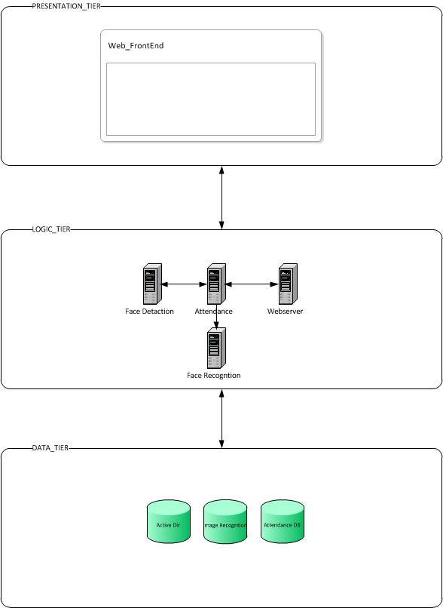

Slide 11
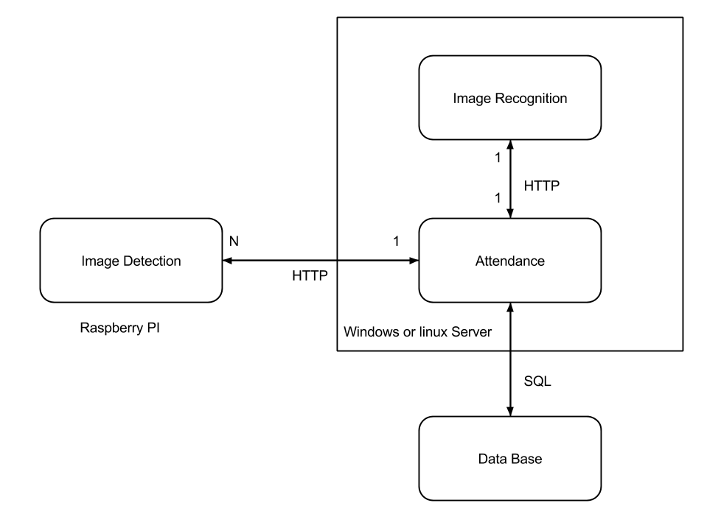
Component relations

Slide 12
Implementation:
For the prototype, we used a workstation with a webcam for rapid testing.
All backend infrastructure was provided by the CCSE department.
For Image detection , we used OpenCV’s available classifiers for frontal faces.
We have used HAAR classifiers, which give more accurate detection with respect to time taken to classify.

Slide 13
Implementation:
For detection we modified the code from:
www.github.com/sawhney/ObjectDetection
To be able to crop the faces from the images
And for demo purposes display the image with the faces highlighted
We later used some code from opencv.org to do training for facial recognition but we had a problem with one of the opencv built in function: creatEigenFaceRecogniser()

Slide 14
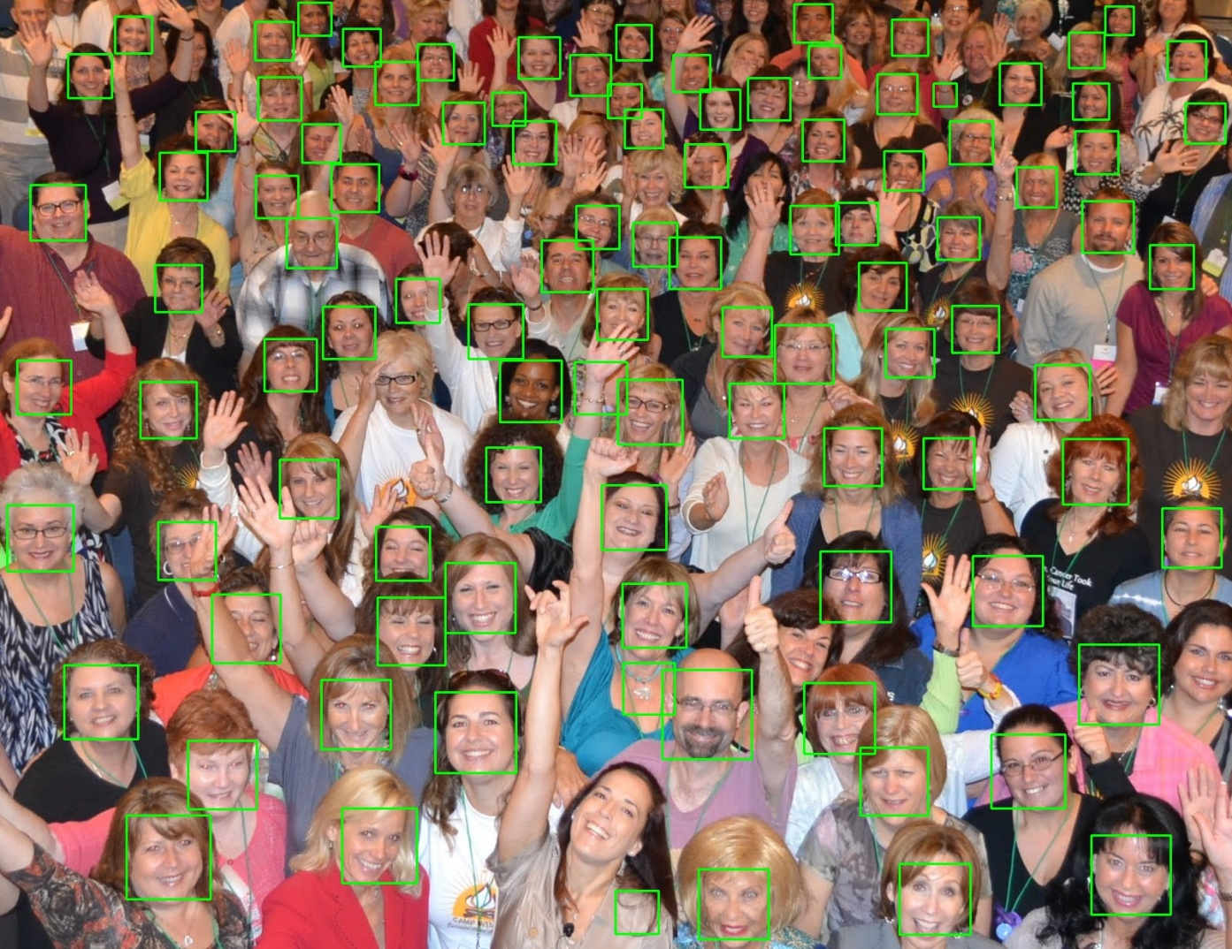
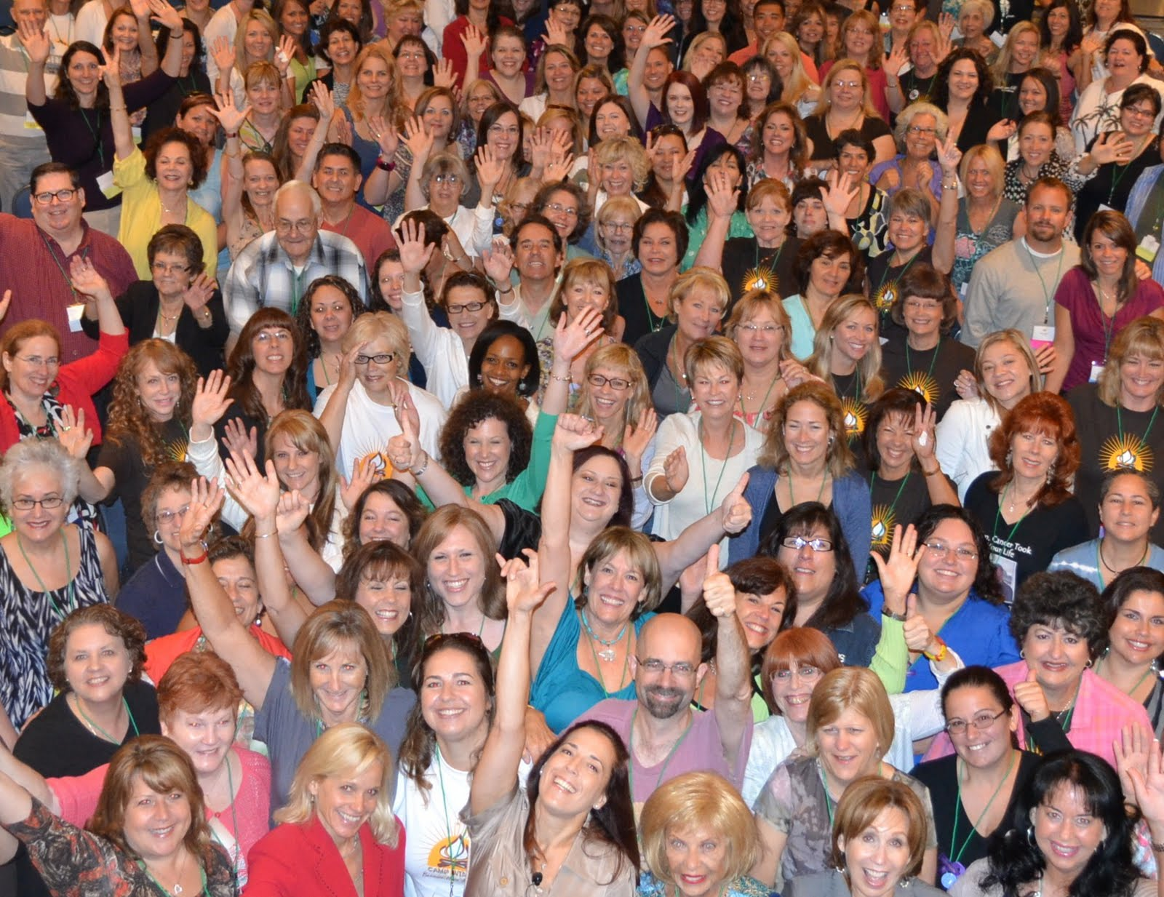
Image Detection

Slide 15
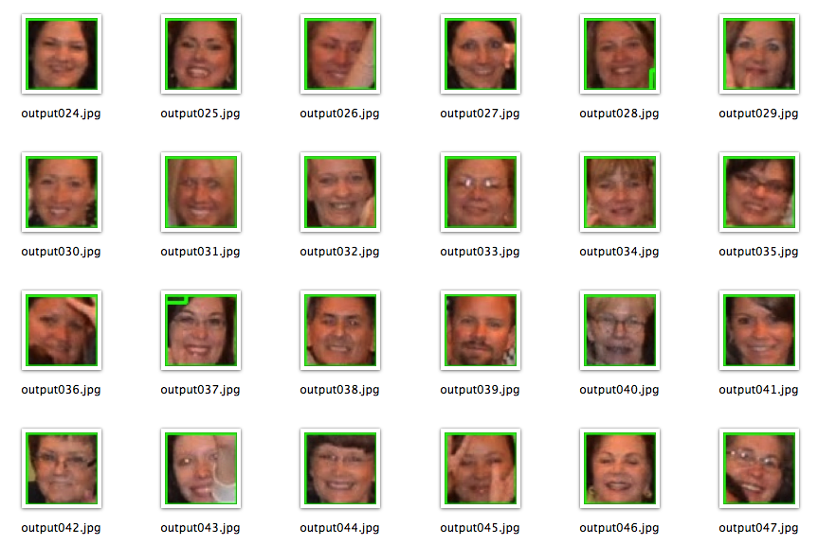
Cropped Images

Slide 16
Issues
Using OpenCV with Raspberry PI:
Building OpenCV from source is time consuming.
OpenCV is not usable with Raspberry Pi camera by default.
Access to VM provided by CCSE:
While working on the backend VM , access was lost and was later resolved through the System Administrator.

Slide 17
Thank you for listening
Please feel free to ask questions

